Slide 1
Sharing and archiving research data
Elin Stangeland, University of Oslo Library, Digital services
29/10/2020​

Slide 2
Terminology
Sharing
Archiving
  Open
  Controlled access
Publishing
  Journal
  Archive?

Slide 3

Open science
Open science means transparency and knowledge-sharing in research processes to make knowledge accessible across academic groups, sectors and national boundaries. The concept of open science encompasses the entire research process […].
Source: The Research Council of Norway. Policy for open science 2020
Image by: opensourceway

Slide 4
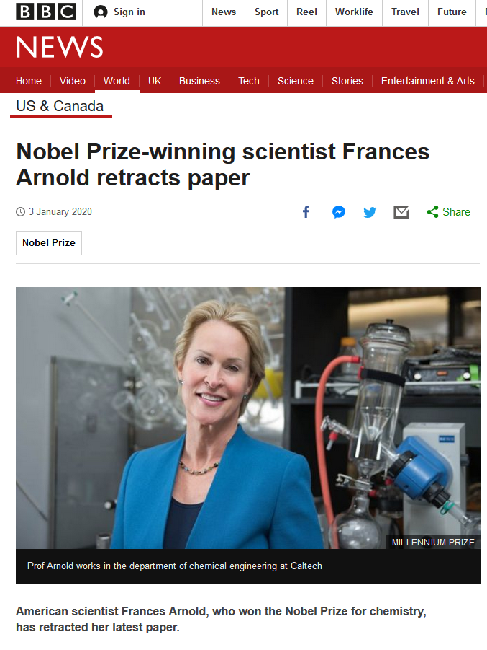
Source: https://www.bbc.com/news/world-us-canada-50989423

Slide 5
Why open research?
“My main argument for opening all parts of the process is that is “sharpening” the research process. You cannot be sloppy if you know that it will be exposed”. Alexander R. Jensenius, 2020
improved quality of research by building on previous works and compiling research data in new ways
transparency in the research process and better opportunity for verifiability of scientific results
increased cooperation and less duplication of research work
increased innovation in the private and public sectors
efficiency improvement and better utilisation of public funds
Sources: https://www.uio.no/english/for-employees/support/research/research-data-management
/policies-and-guidelines/index.html and https://www.arj.no/2020/08/27/open-research/

Slide 6
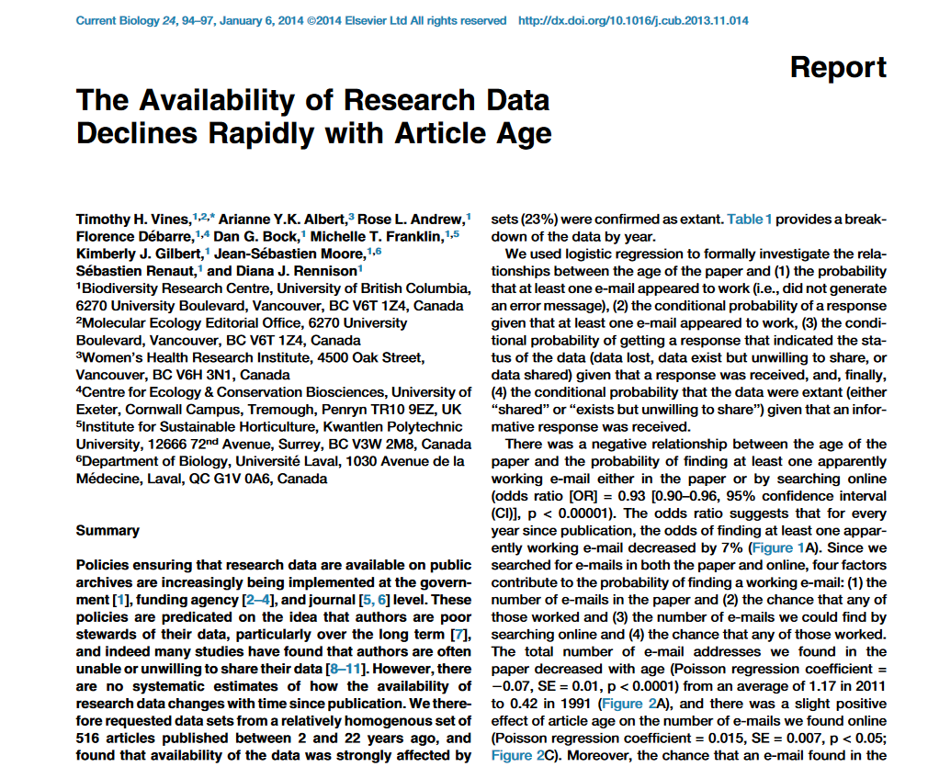

Slide 7
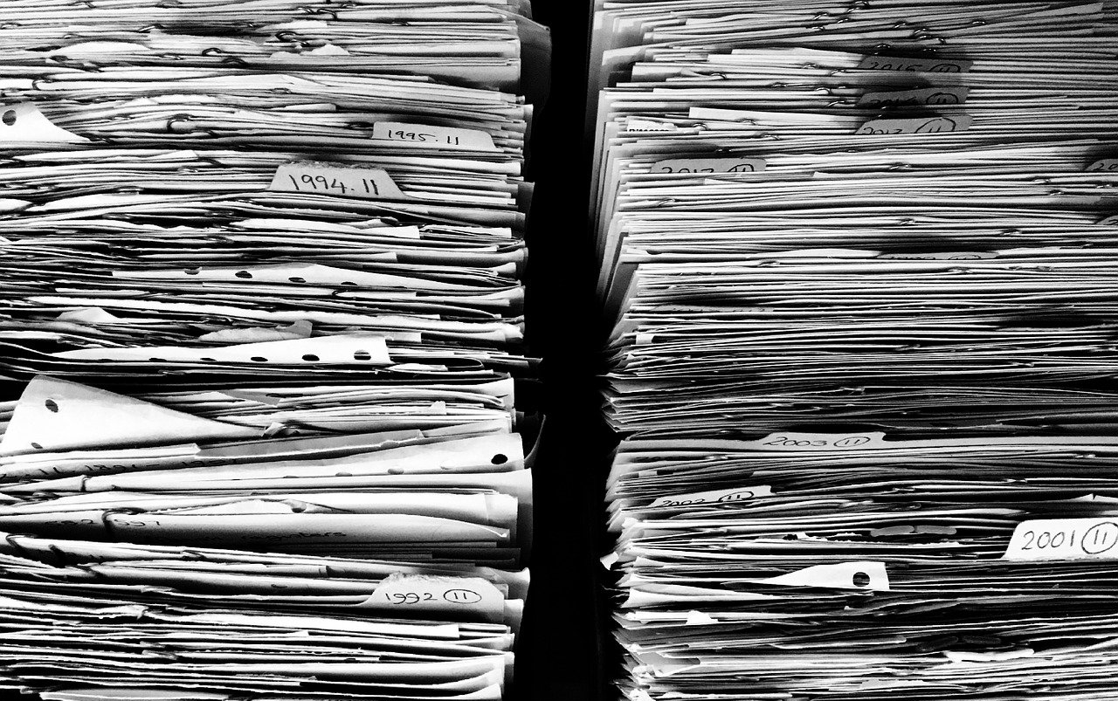
Reasons for archiving
Career benefits - data publication may lead to increased visibility, reuse and citation and therefore recognition of scholarly work.
Scientific progress – make research more robust, enables new collaborations, new data uses and establishing links to the next generation of researchers. Avoid duplication of work. Makes using data in teaching easier.
Norms – of the project, research group, or discipline
External drivers – funder requirements, publisher requirements

Slide 8
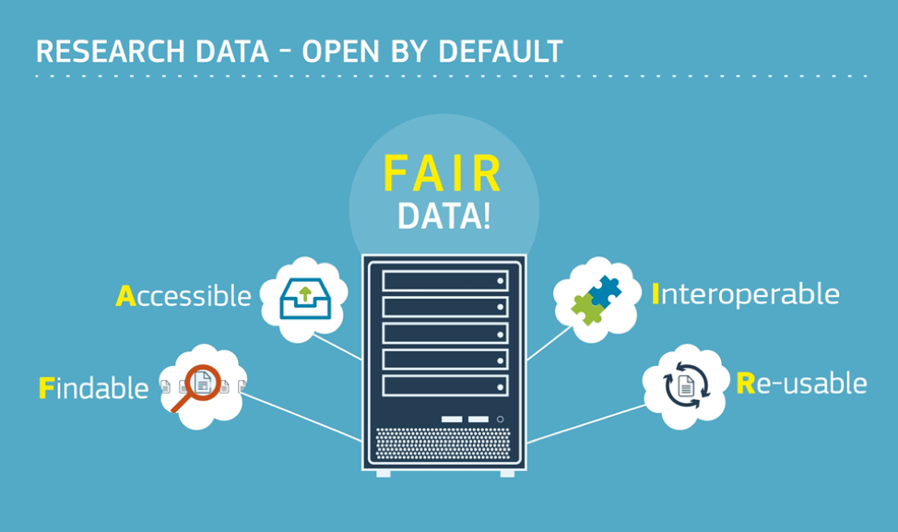

Slide 9
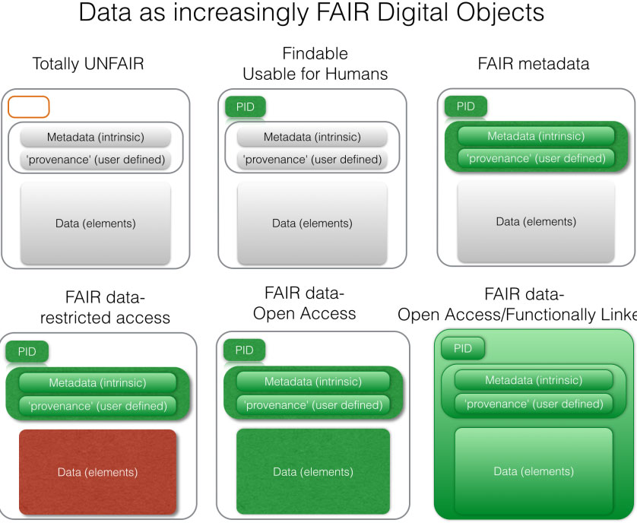
Source: FORCE11.org

Slide 10
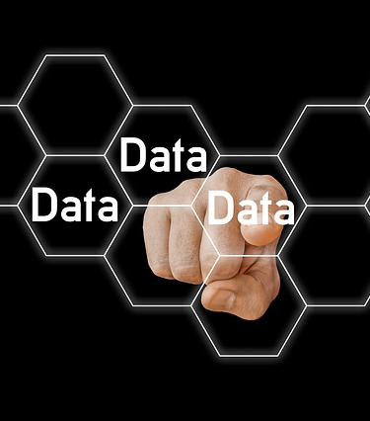
Selecting data for archiving
Does your dataset have reuse potential?
Is your dataset reusable?

Slide 11
Preparing for archiving
Select of scientific relevance and worth archiving over the long term. Remove unneeded data.
Make sure that no personal or confidential data is included.
Use consistent and meaningful file names that reflect the file content, avoiding spaces and special characters.
Choose accessible, patent-free, open formats, for which software is widely available on a variety of platforms.
Make sure you have the necessary documentation in place
When your data consists of many files, you can group them in zip bundles according to their content or file format, to make upload and download easier.
If you have more than 10 GB of data consider upload alternatives to your archive
Source: https://data.4tu.nl/info/fileadmin/user_upload/Documenten/Deposit_Guidelines_2019.pdf

Slide 12

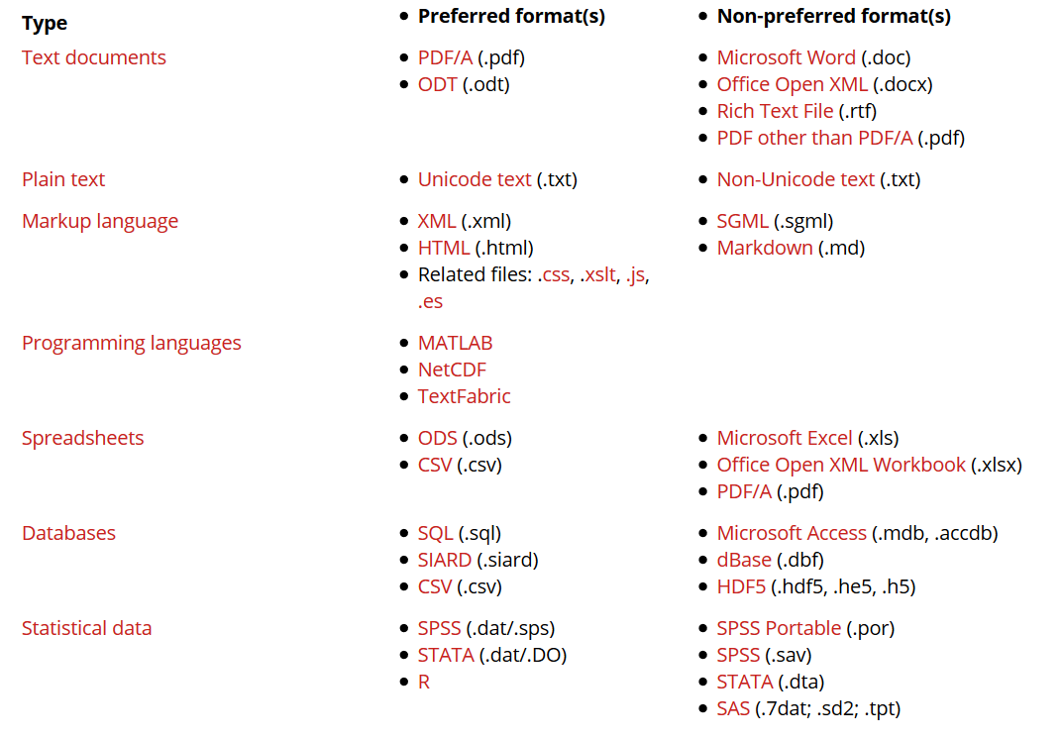
https://dans.knaw.nl/en/about/services/easy/information-about-depositing-data/before-depositing/file-formats

Slide 13

Different types of data archives
Domain specific data repository
General purpose repository
Institutional data repository
As supplementary material to an article
Data paper

Slide 14
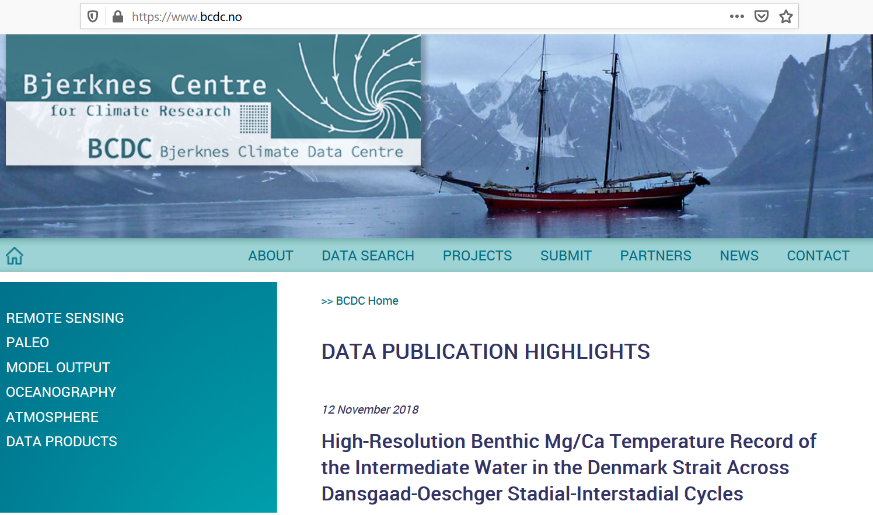
Source: https://www.bcdc.no/

Slide 15
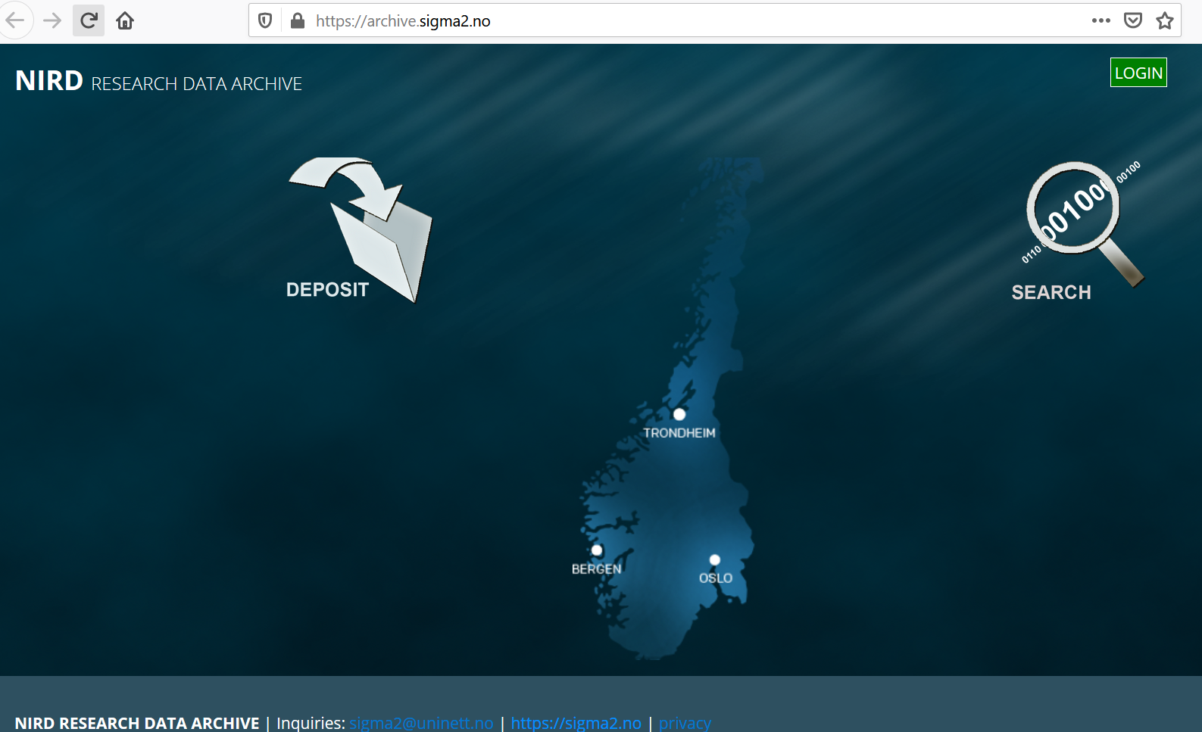
How to: https://www.sigma2.no/research-data-archive-user-guide

Slide 16
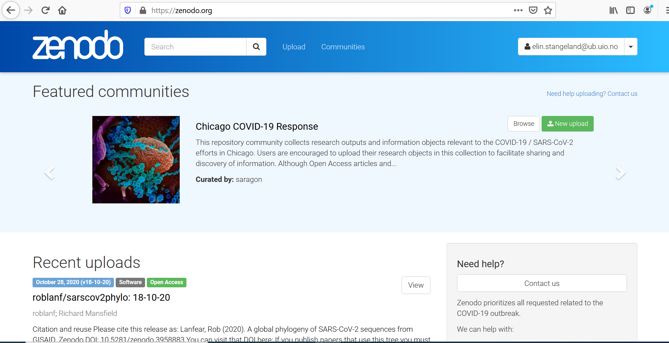

Slide 17
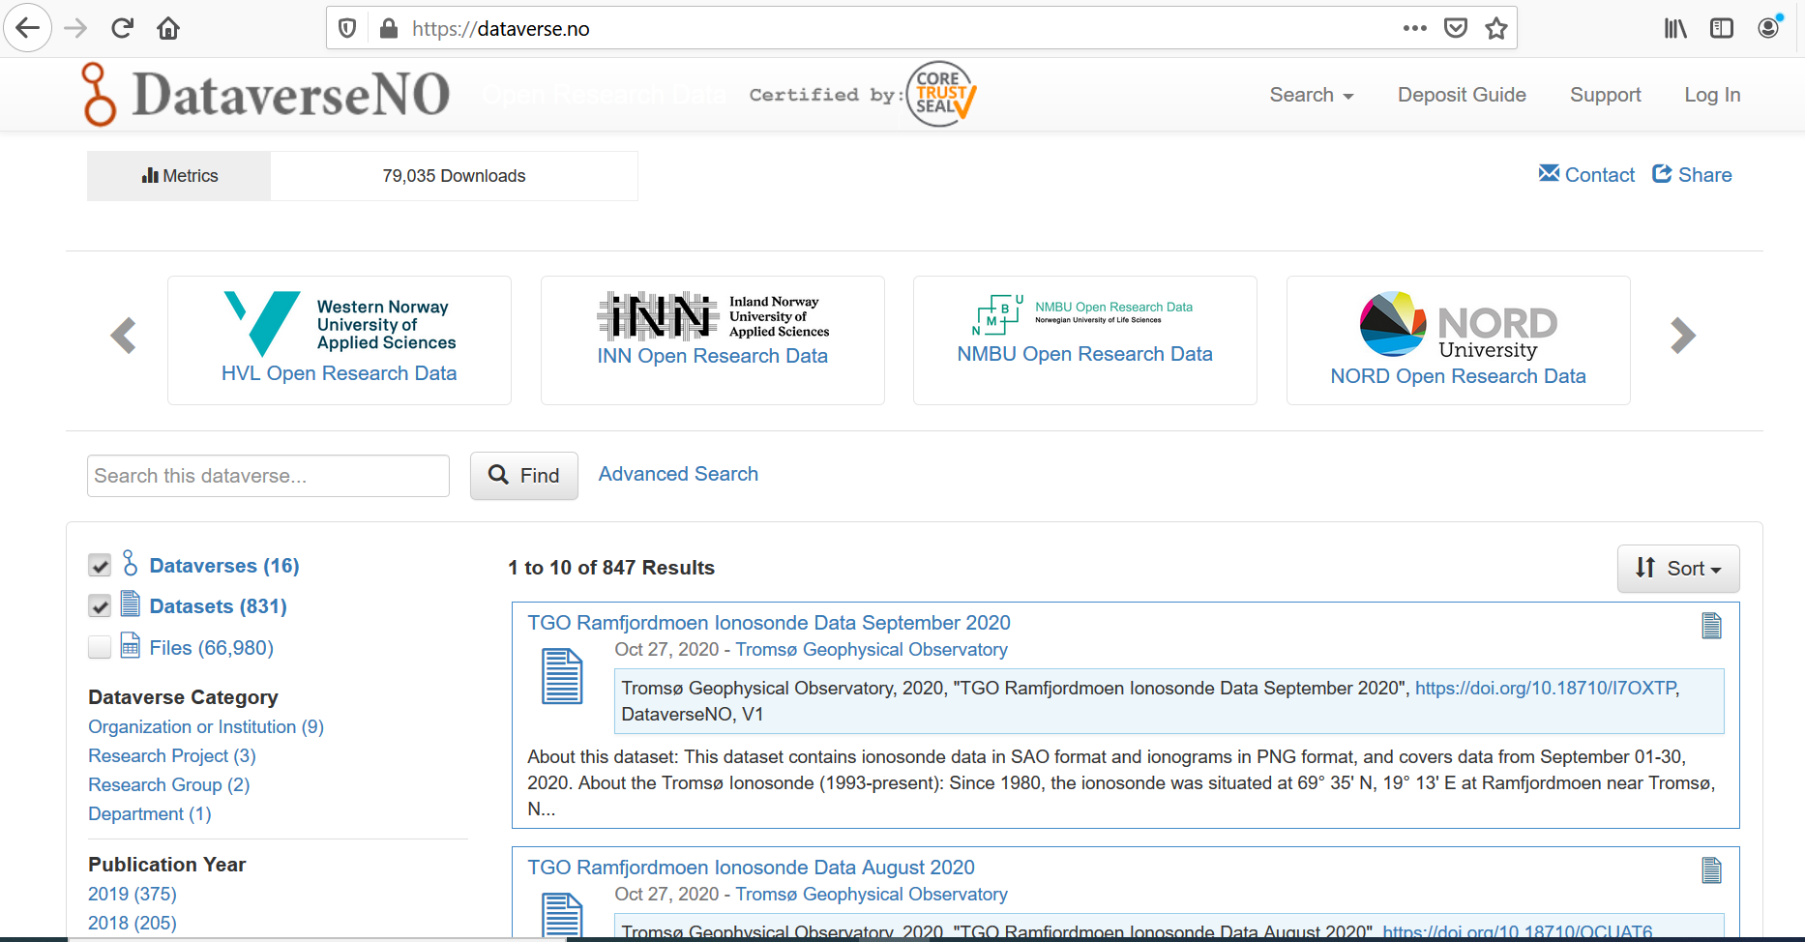

Slide 18
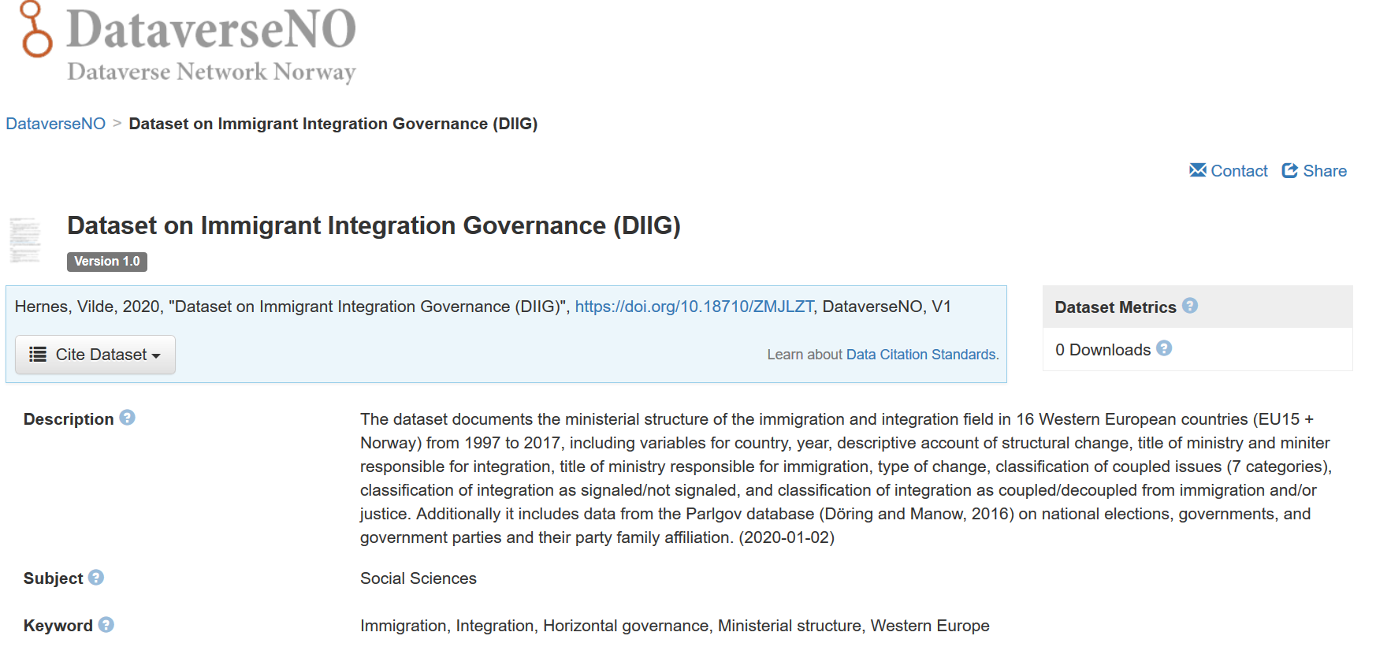

Slide 19
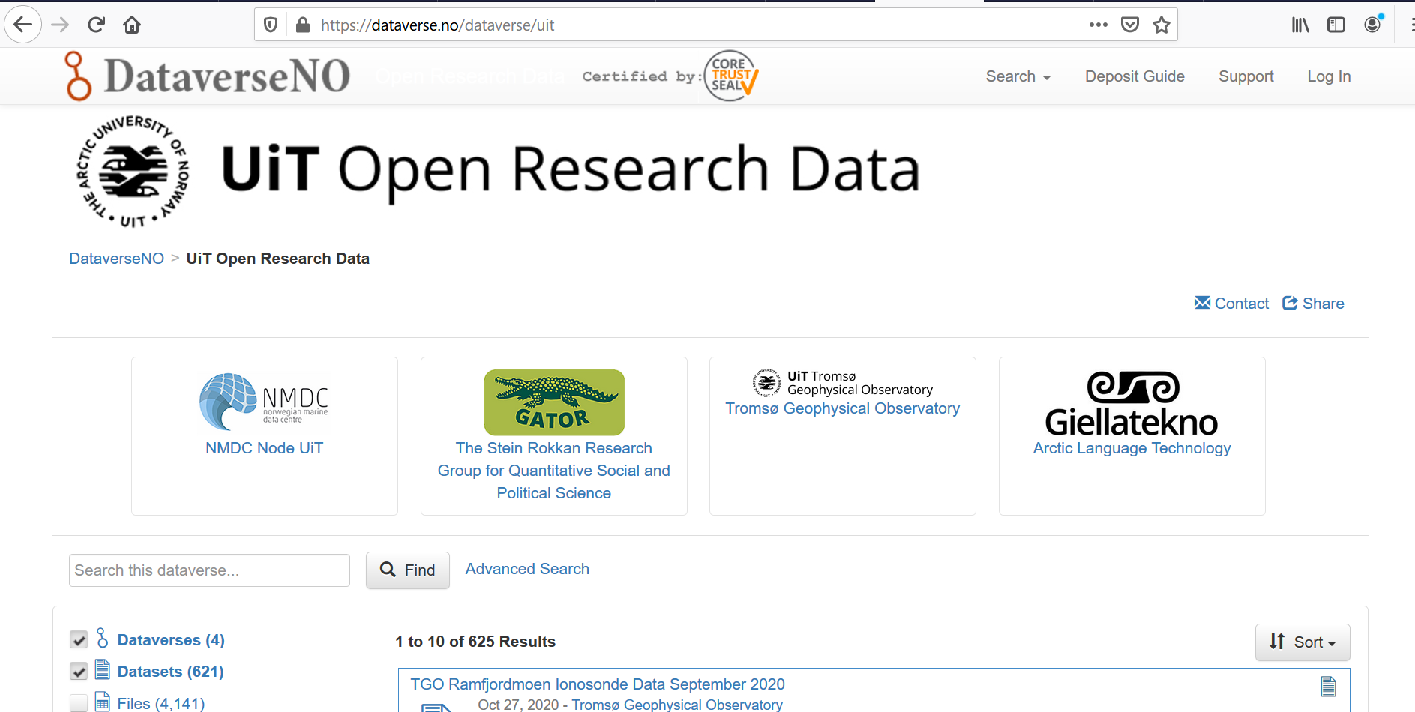

Slide 20
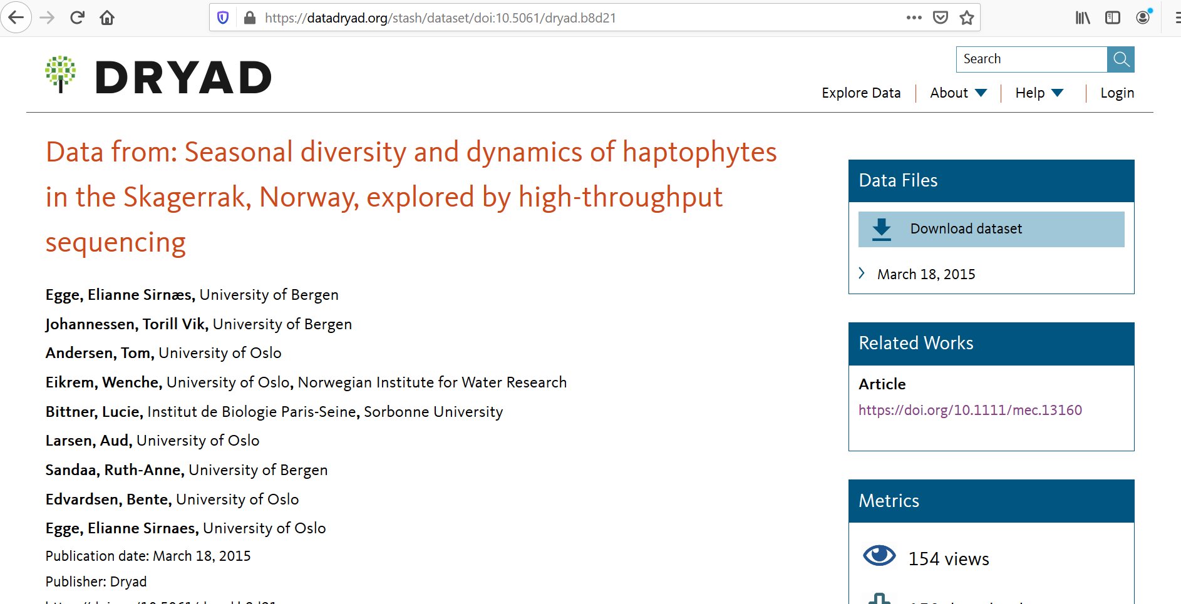
Sources: https://datadryad.org and https://doi.org/10.5061/dryad.b8d21

Slide 21
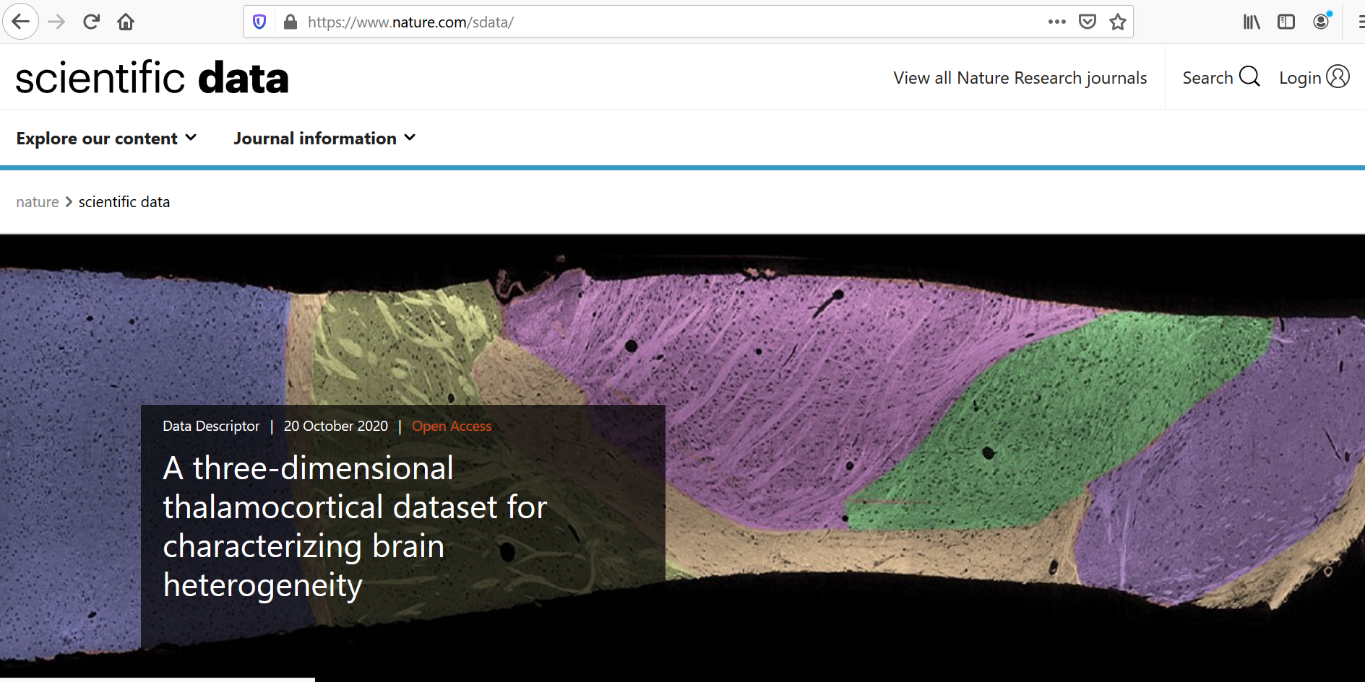

Slide 22
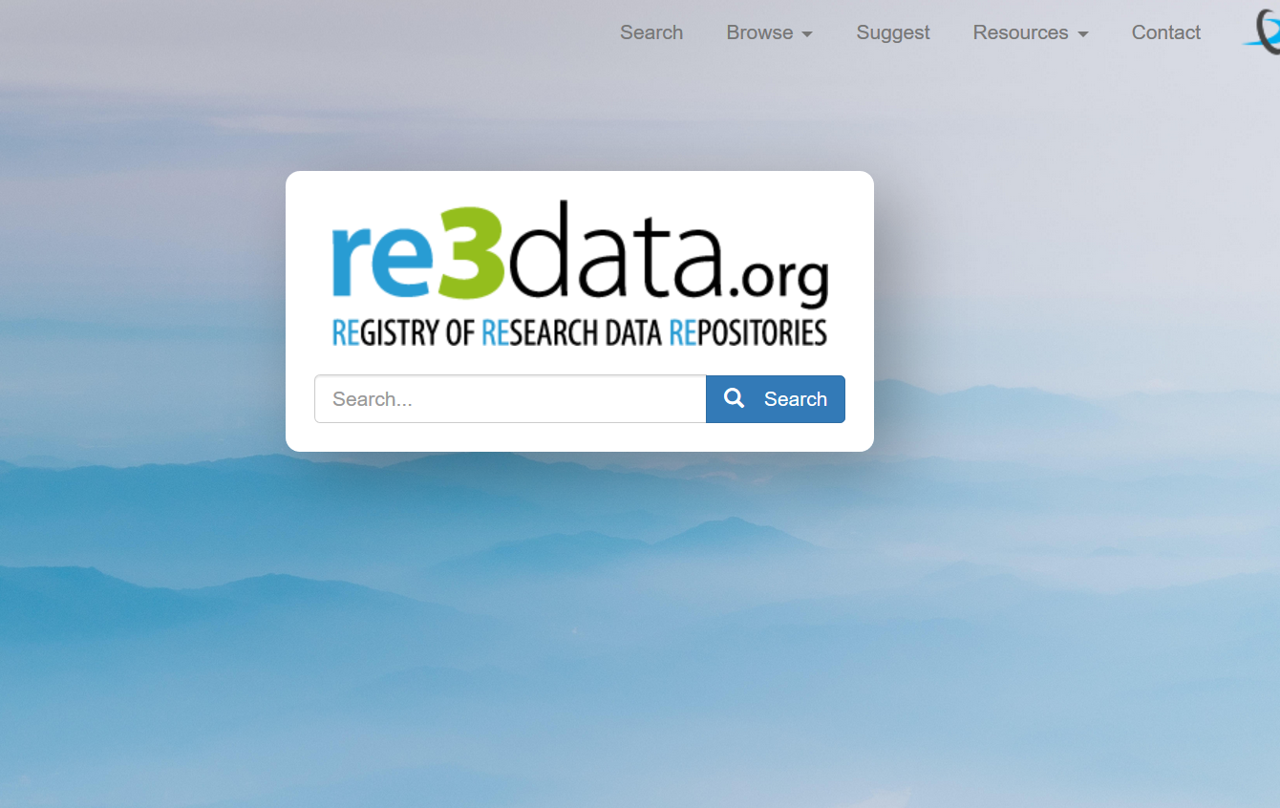

Slide 23
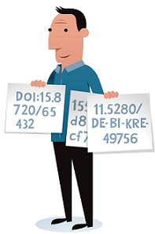
Persistent identifiers (PID)
When data are published, they should have a persistent identifier, a PID.
Eases referencing a dataset – as web url’s tend to change/stop working
Common types PID:
  Digital Object Identifier (DOI)
  Uniform Resource Name (URN)
  Permanent Uniform Resource Locator (purl)
Illustration by Jørgen Stamp digitalbevaring.dk CC BY 2.5 Denmark

Slide 24
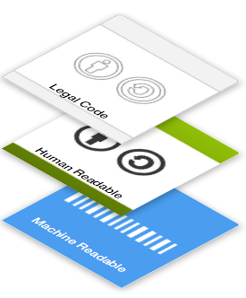
About licensing
A license agreement is a legal arrangement between the creator/depositor of the data set and the data repository, signifying what a user is allowed to do with the data.
Often Creative Commons licenses are used
Notes:
https://creativecommons.org/choose/

Slide 25
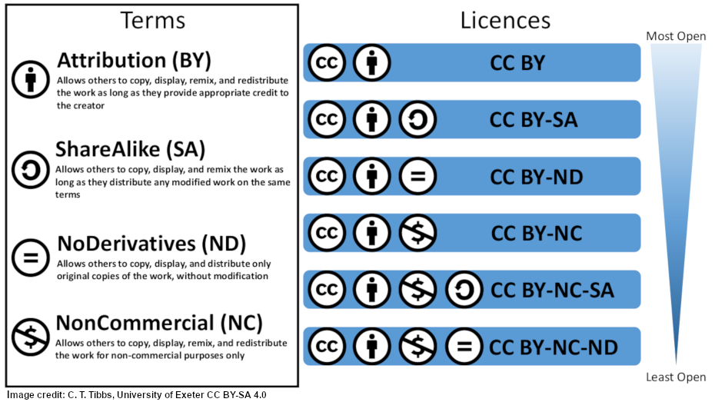

Slide 26

Might be the solution at UiO – to be determined
But – there are situations where CC0 are inappropriate
  Personal information – for which consent is not cleared
  Copyright issues
  Orphan works – where rights holders are unknown or cannot be traced

Slide 27
Sources
Bjerknes Centre. Bjerknes Climate Data Centre. https://www.bcdc.no/
Creative Commons. https://creativecommons.org/
DataverseNO. https://dataverse.no/
DataverseNO. Prepare your data. https://site.uit.no/dataverseno/deposit/prepare/
Mons, Barend et al. “Cloudy, increasingly FAIR; revisiting the FAIR Data guiding principles for the European Open Science Cloud.” Inf. Services and Use 37 (2017): 49-56. https://doi.org/10.3233/ISU-170824
Re3data. https://www.re3data.org/
Sigma2. NIRD research data archive. https://archive.sigma2.no/
University of Tromsø. Open Resarch Data Archive. https://dataverse.no/dataverse/uit
Vines, Timothy H. et al. «The Availability of Research Data Declines Rapidly with Article Age.” Current biology 24 (2014): 94-97. http://dx.doi.org/10.1016/j.cub.2013.11.014
Zenodo. https://zenodo.org/
Photos from Pixabay if not otherwise indicated. Scientist: RAEng_Publications.

