Slide 1
DATA CLASSIFICATION AND STORAGE SOLUTIONS
November 3rd 2020
Ivana Malovic, Universtiy of Oslo Library
Based on original presentations by Anne Bergsaker (University Center for Information Technology), Annika Rockenberger (University of Oslo Library ) and Elin Stangeland (University of Oslo Library)

Slide 2
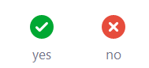
Zoom Feedback Test
Open the menu “Participants” and click on “Yes” in the bottom of the menu. Then click on “No”.

Slide 3
Types of research data
Qualitative or Quantitative
Observational; Computational; Textual; Experimental; Records
Personal data or not ?
  General (non-sensitive) personal data:
    name, address, e-mail, exam grades, case documents, e-mail communication, audio-/video-recordings, images, log-in activity
  Sensitive personal data:
    health, biometric, genetic, ethnic, political /philosophical/religious perceptions and beliefs, sexual orientation, trade-union membership, criminal offence information

Slide 4
On ownership
All UiO information shall have an unambiguous and identifiable owner.
Anyone should easily be able to find out who is responsible for keeping the information updated, maintained and correctly labeled.
The «information owner» is responsible for the assessment used to place the information in its given category.
In those cases where an owner cannot be identified, the University Director is responsible for the information.

Slide 5
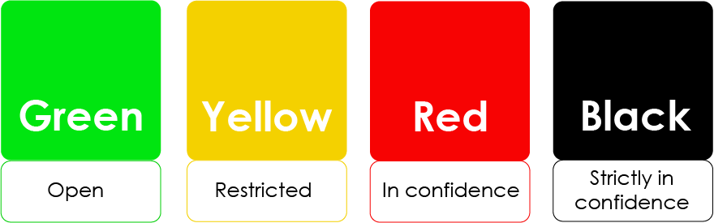
On ownership - How to decide which class to use?
Always put the information in a sufficiently safe class.
If you are not sure whether to your information is red or yellow, choose red.

Slide 6

Data ClassIfication

Slide 7
Classifying your data
https://www.uio.no/english/services/it/security/lsis/data-classes.html

Slide 8
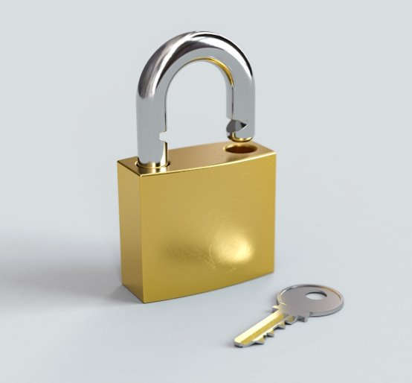
What is green data
This class is used when it does not cause any harm to the institution if the information becomes known to unauthorized persons.
Any research that is published openly. Information that is not public, needs to be removed first.
Teaching material that is not subject to copyright
Completely anonymous data
Data without any financial or commercial value
Statistics

Slide 9
Question 1
Do you think you will work with green data?

Slide 10

What is yellow data?
This class is used when it could cause a certain damage to the institution if the information becomes known to unauthorized persons.
Documents that you don’t want everyone else to read
De-identified data where the key is locked away and stored safely away from the data
Data sets containing minor amounts of non-sensitive personal data
E-mail attachments that don’t contain information that needs protection
Unpublished research material
Texts and pictures under copyright

Slide 11
Question 2
Do you think you will work with yellow data?

Slide 12

What is red data?
This class is used if it could cause harm to public interests, the university or individuals if the information becomes known to unauthorized persons.
De-identified data where the key is available and stored with the data
Special categories of personal data
Personnel files
Information relating to e.g. safety systems in buildings or IT systems
Health related data

Slide 13
Question 3
Do you think you will work with red data?

Slide 14

What is black data?
This class is used if it could cause significant harm to public interests, the university or individuals if the information becomes known to unauthorized persons.
Research data that requires extra protection
Large quantities of sensitive personal data
Large quantities of health related data
Research data that is of great financial or commercial value

Slide 15
Question 4
Do you think you will work with black data?

Slide 16

You must familiarise yourself & comply with the data processing guidelines.
Consult with your PI, local IT or USIT!

Slide 17
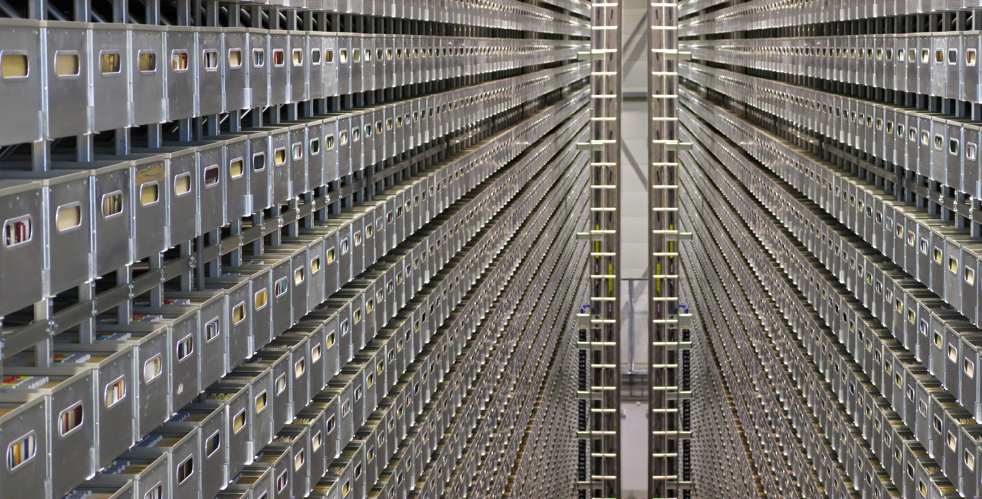
STORAGE SOLUTIONS
Automated Storage Facility at the National Library of Norway. Picture by Tore Brattli. Source https://flic.kr/p/hn3y5D

Slide 18
Question 5
Are you primarily using a private laptop/computer for your research?

Slide 19
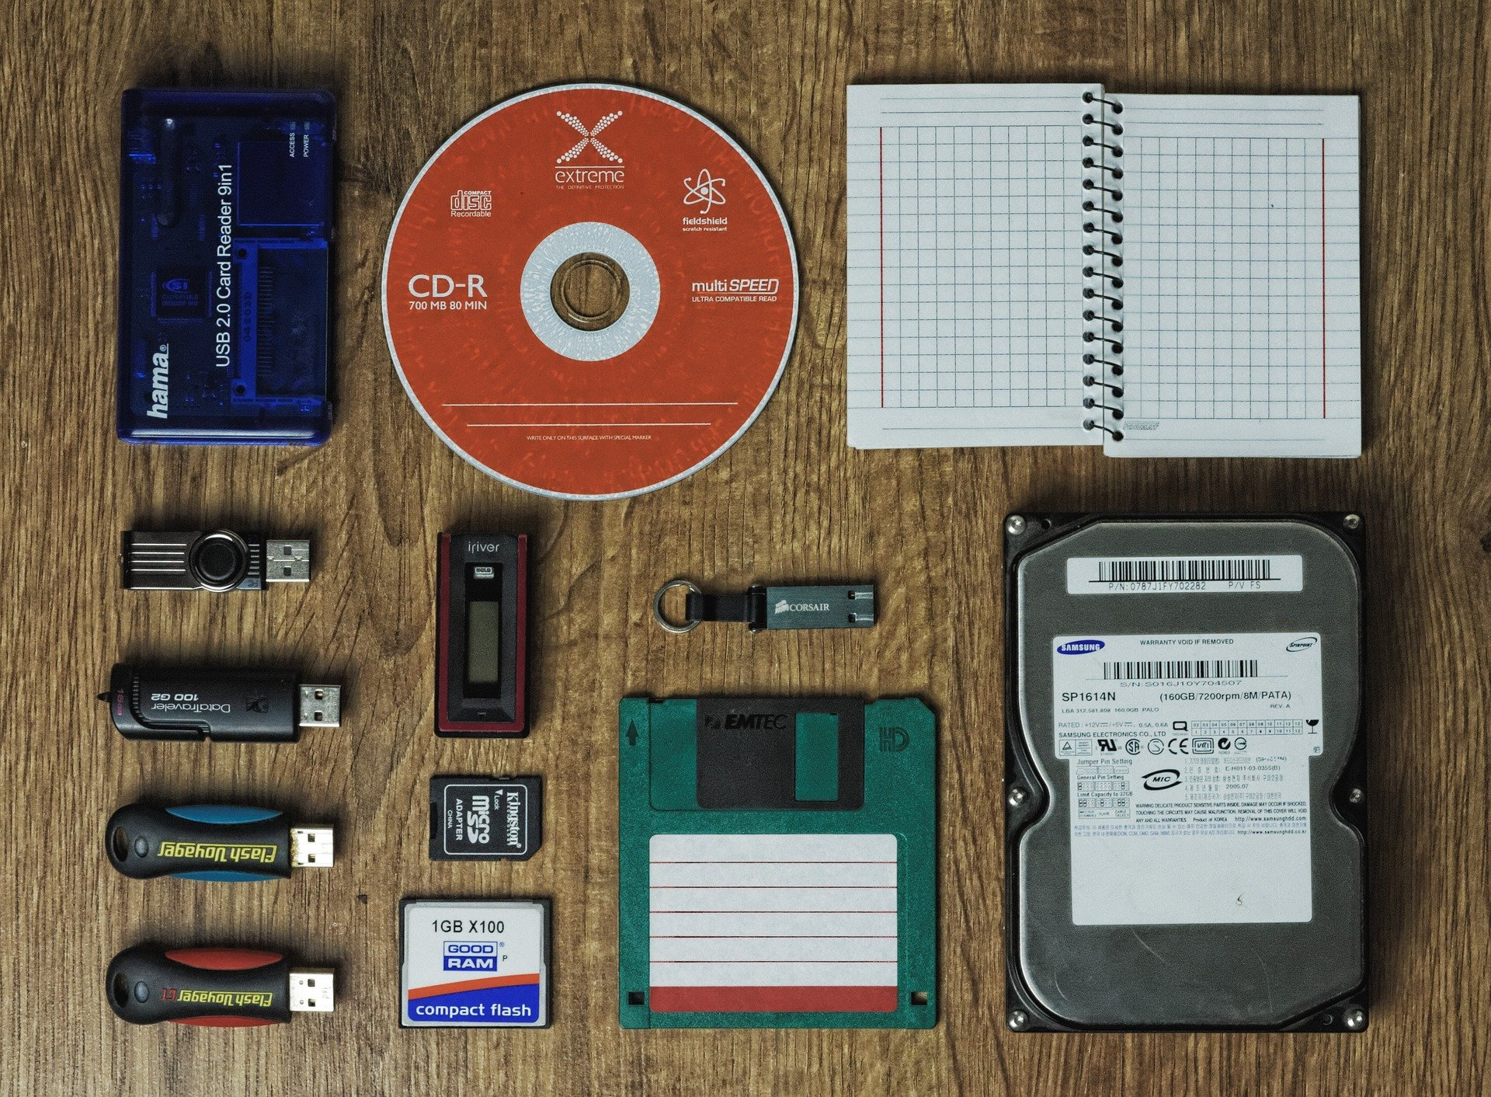
Where can you store the different types of data?
Data storage guide:
https://www.uio.no/english/services/it/security/lsis/storage-guide.html

Slide 20
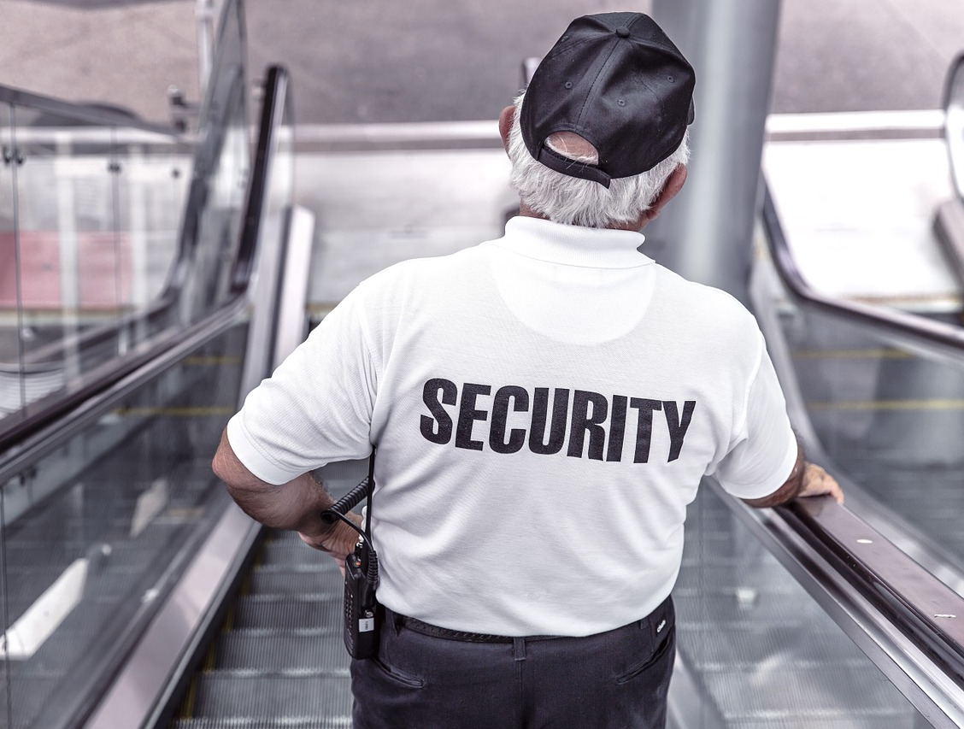
Where can you store the different types of data?
Green data:
  anywhere you want, but ideally not only on your private laptop (very vulnerable!)

Slide 21
Where can you store the different types of data?
Yellow data:
  encrypted hard drive
  UiO cloud solutions (UiO OneDrive, UiO G-Suite, …)
  UiO home directory (M: )
  UiO storage hotel («lagringshotell»)
  UiO e-mail; UiO Teams; UiO Nettskjema; UiO Canvas…
  Not your private laptop or phone, unless they are encrypted and safely used

Slide 22

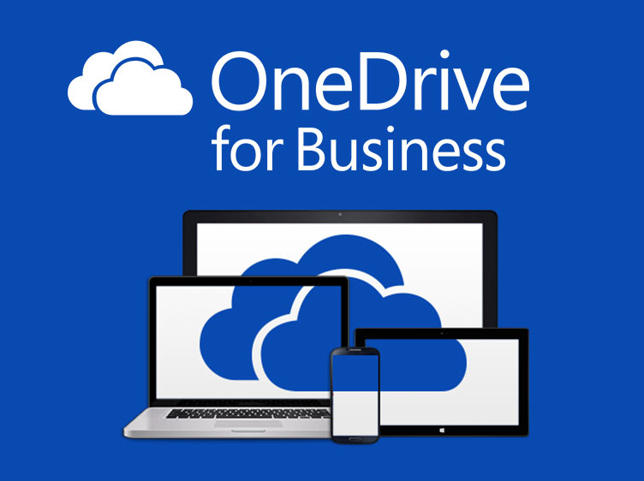

UiO commercial cloud solutions
Microsoft Office365 + OneDrive
https://www.uio.no/english/services/it/store-collaborate/o365/
Google Drive + Docs, Sheets, etc
https://www.uio.no/english/services/it/store-collaborate/gsuite/

Slide 23
Question 6
We have shown you UiO‘s commercial cloud solutions, Microsoft OneDrive & Office365 and Google G-Suite.
Are you aware of other commercial cloud solutions that UiO offers?

Slide 24
Where can you store the different types of data?
Red data:
  Fully encrypted disc, memory stick or external harddrive
  Services for sensitive data – TSD
  UiO Storage Hotel*
  UiO Vortex*
  *see Storage guide for details!
Source: https://www.uio.no/english/services/it/security/lsis/storage-guide.html

Slide 25
Where can you store the different types of data?
Black data:
  Services for sensitive data – TSD

Slide 26
Question 7
Do you think you will be using TSD during your research at UiO?

Slide 27
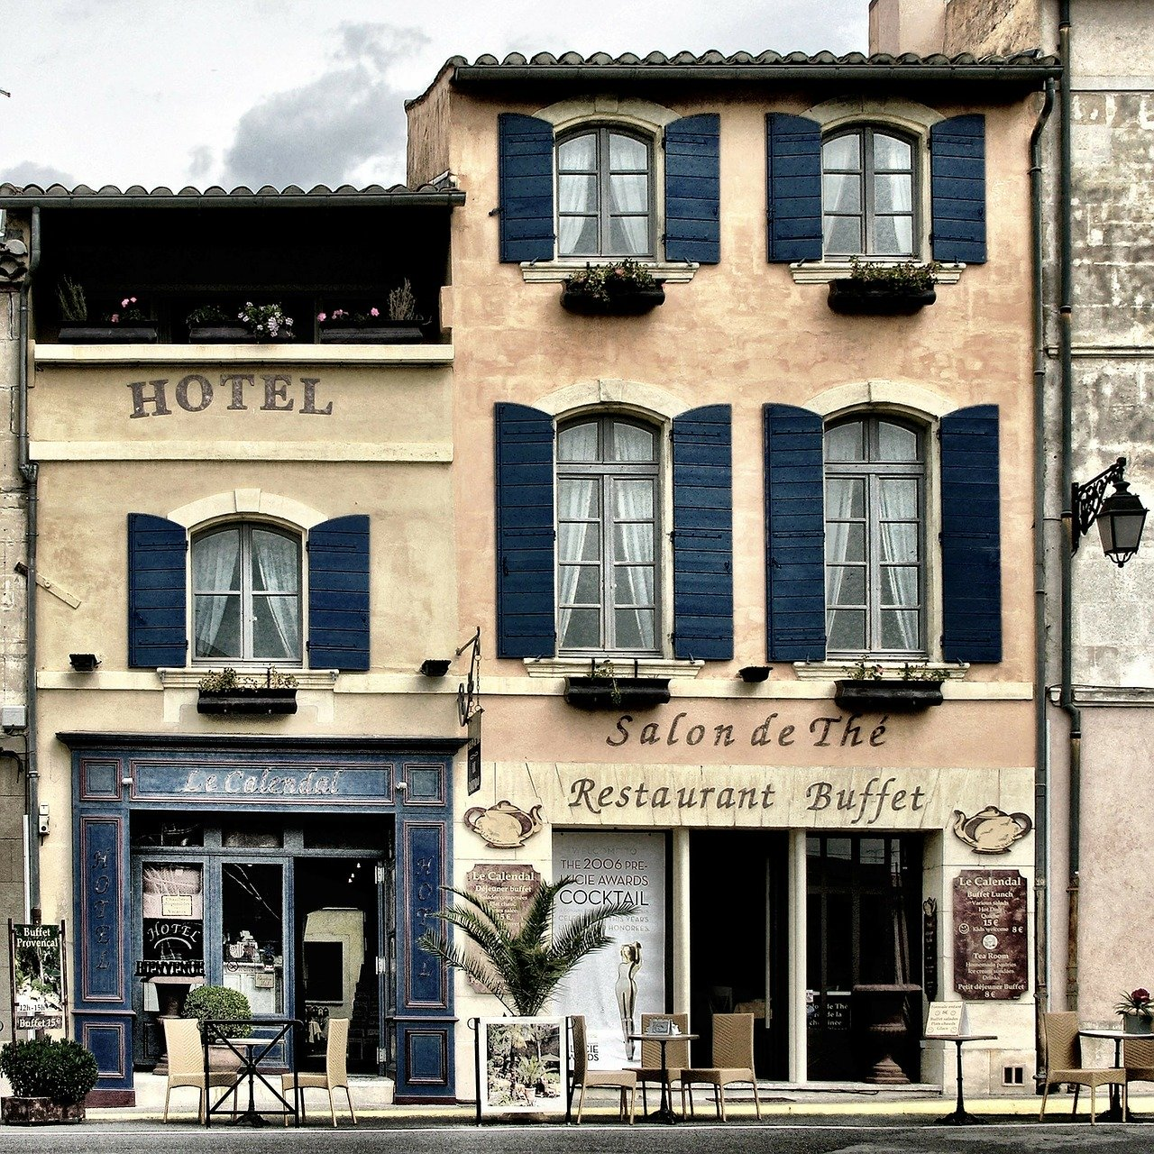
Storage hotel
Remote disc where you can safely store and access your data
Safer than the cloud solutions, so you can store up to red data
Contact local IT for access
Not free of charge
Guidelines on costs and access to storage hotel: https://www.uio.no/english/services/it/store-collaborate/storage-hotel/

Slide 28
hf-depot
Researchers at HF may be assigned storage space for job-related material (hf-depot.uio.no)
Work areas that act as common disks, and are to be used when the home area isn't suitable or doesn't have sufficient capacity.
Each researcher or group of researchers may be assigned "their" area within their area (institute or center).
The service is currently free of charge.
Storage services at HF: https://www.hf.uio.no/english/services/it/research-and-dissemination/storage-solutions/

Slide 29
Question 8
Do you know where to find contact information for your local IT and the Center for Information Technology (USIT)?

Slide 30
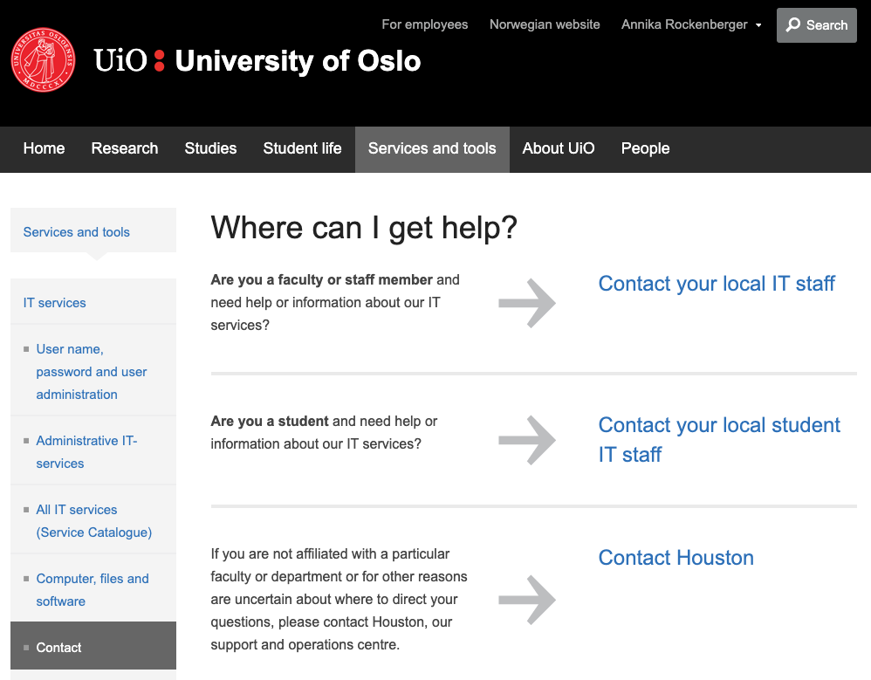
Contact Points for IT at UiO
https://www.uio.no/english/services/it/contact/

Slide 31
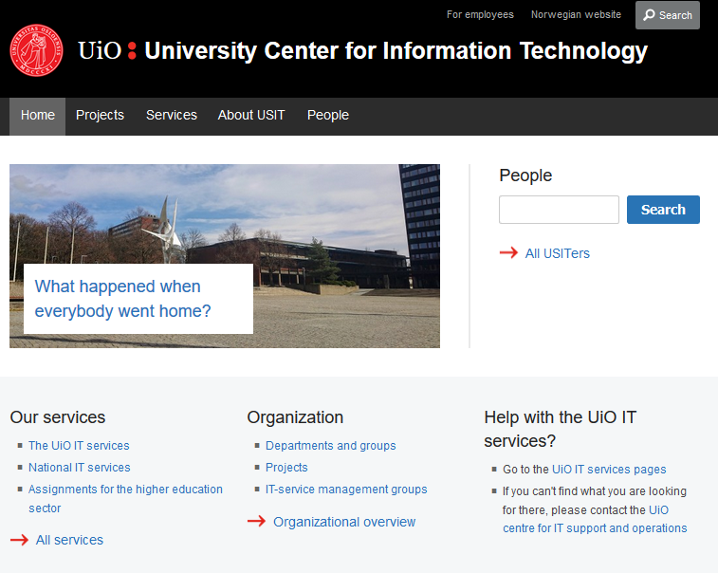
University Center for Information Technology (USIT)
https://www.usit.uio.no/english/

Slide 32
Question 9
Do you have a routine for making backups for your research files (manuscripts, data, etc.)

Slide 33
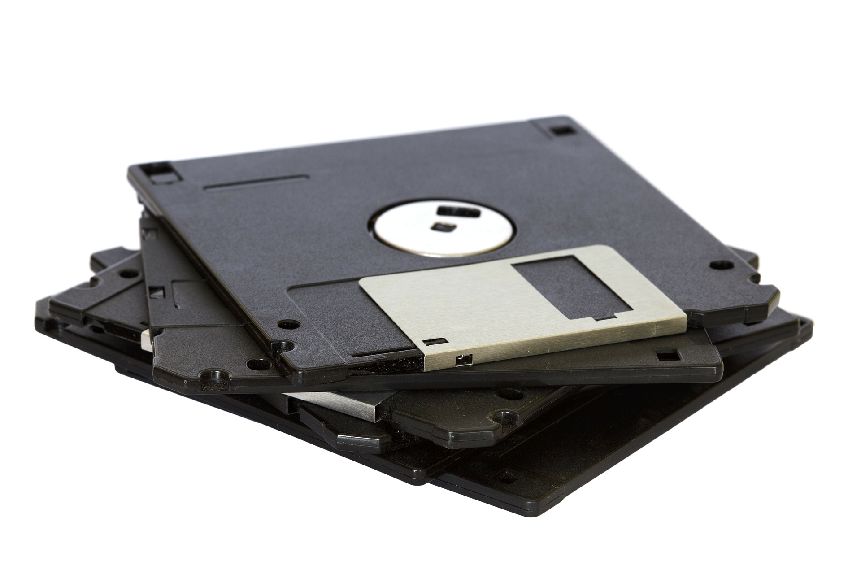
Storage solutions and backup
Use safe storage solutions, where data/files are backed up
Always keep a copy of your raw data material safely hidden away (like a folder on storage hotel that you never edit)
Saving files only on your own computer is not safe!
A memory stick or an external hard drive is not safe!
How much extra work would take to recreate all your data or your work?
https://www.uio.no/english/services/it/store-collaborate/backup/

Slide 34
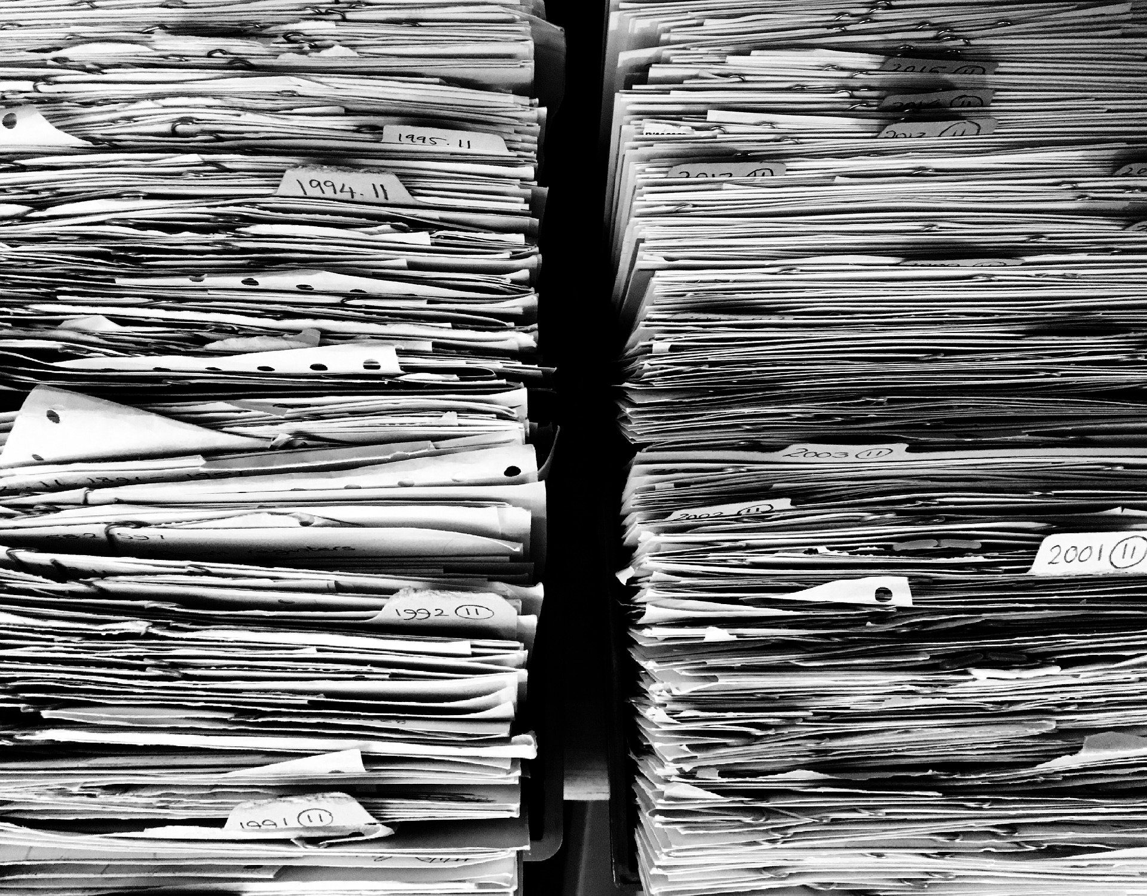
Save all the files!
«For every result, keep track of how it was produced» (Sandve et al, 2013)
Save processed data at important stages in the project
Save processed data and analysis/methods for every table and graph

Slide 35
Useful links
Data management at UiO:
https://www.uio.no/english/for-employees/support/research/research-data-management/
The UiO data storage guide: https://www.uio.no/english/services/it/security/lsis/storage-guide.html
Data classification guide: https://www.uio.no/english/services/it/security/lsis/data-classes.html
Storage and collaboration:
https://www.uio.no/english/services/it/store-collaborate/
Contact Points for IT at UiO: https://www.uio.no/english/services/it/contact/
University Center for Information Technology (USIT):
https://www.usit.uio.no/english/
Backup: https://www.uio.no/english/services/it/store-collaborate/backup/

Slide 36

5 min for coffee or tea…
…and then Q&A!

