Slide 1
Introduction to research data management
Elin Stangeland, Digital services
Annika Rockenberger, Reference and Research Section
University of Oslo Library

Slide 2

Upcoming sessions…
Data management planning 30/10 - 9:00
Data classification and storage selection 3/11 – 9:00
Organising your research data 5/11 – 9:00
Privacy and data protection 10/11 – 13:00
Sharing and archiving research data 11/11 – 13:00

Slide 3
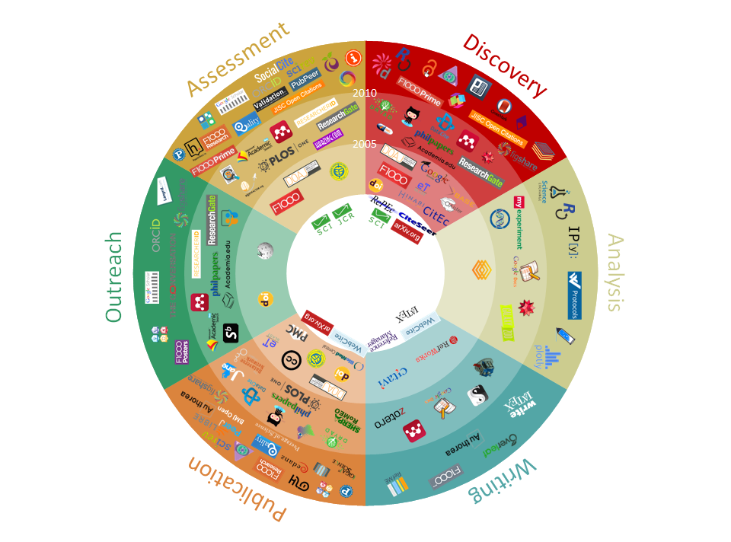
Source: 101 Innovations in Scholarly Communication. CC BY. Source: https://innoscholcomm.silk.co/

Slide 4

Open research / Open science
Open science means transparency and knowledge-sharing in research processes to make knowledge accessible across academic groups, sectors and national boundaries. The concept of open science encompasses the entire research process […].
Source: The Research Council of Norway. Policy for open science 2020
Image by: opensourceway

Slide 5

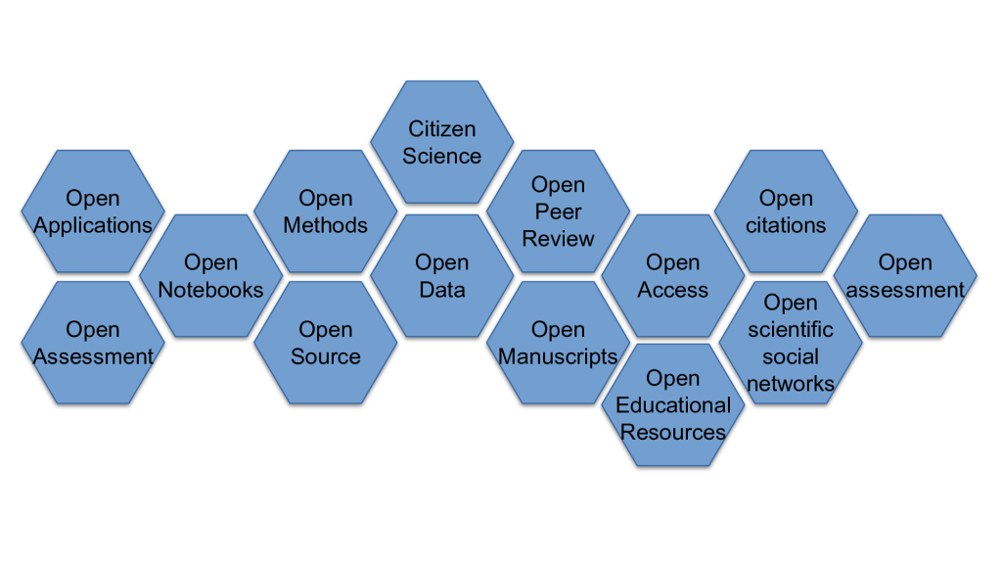
UiO open research in practice
Case – Alexander Refsum Jensenius
Source: www.arj.no/2020/08/27/open-research/

Slide 6

Why open research?
The Research Council of Norway’s new policy for Open Research mentions three main goals
Contributing to a well functioning research system
Contribute to sustainable development
Strengthening trust in research
Source: The Research Council of Norway, policy for Open Research

Slide 7
Why Open research?
“My main argument for opening all parts of the process is that is “sharpening” the research process. You cannot be sloppy if you know that it will be exposed”. Alexander R. Jensenius, 2020
Opening the research process:
  Transparency
  Knowledge sharing
  Supports validation and reproducibility
  Reduces cases of academic misconduct
It helps to maximize:
The quality of and impact of research
Provides the foundations for others to build upon
Source: FOSTER consortium CC BY 4.0

Slide 8
DATA – IN THE HUMANITIES

Slide 9
What is Research Data?
Research data are representations of observations, objects, or other entities used as evidence of phenomena for the purposes of research or scholarship.
(Christine L. Borgman 2015)

Slide 10
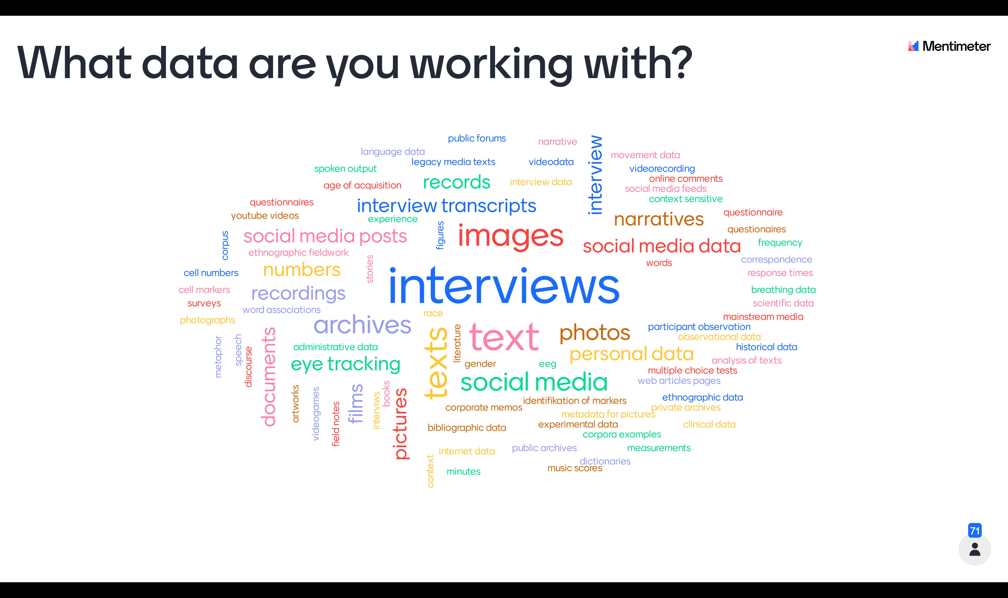
Notes:
Results from initial Menti

Slide 11
What is Research Data?
Observational data – resulting from recognising, noting, or recording facts or occurrences of phenomena, usually with instruments.
Computational data – products of executing computer models, simulations, or workflows.
Experimental data – results of procedures in controlled conditions to test or establish hypotheses or to discover or test new laws.
Records – records of almost any phenomenon or human activity, can be treated as data for research.

Slide 12
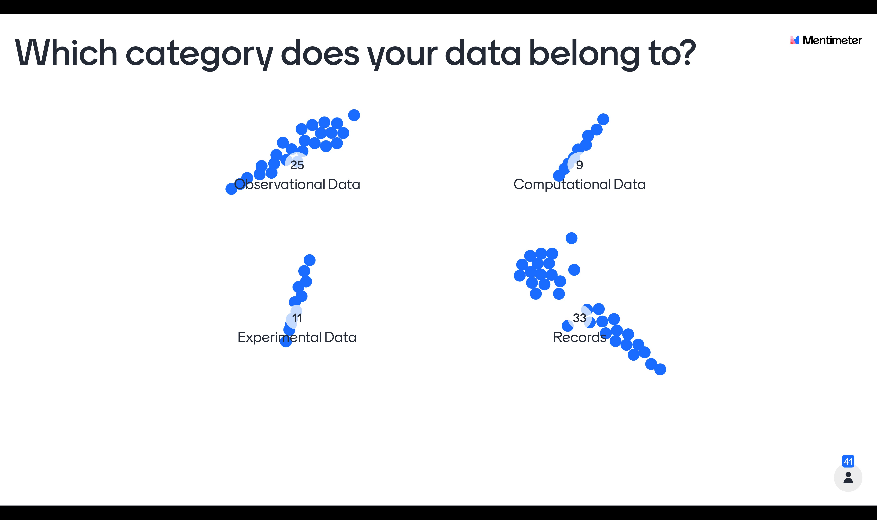
Notes:
Results second round of Menti

Slide 13
Data in the Humanities – Further Reading
Sustainable and FAIR data sharing in the humanities: https://allea.org/portfolio-item/sustainable-and-fair-data-sharing-in-the-humanities/
Data management best practices bibliography: https://www.Zotero.Org/groups/2427138/data_management_best_practices_in_the_humanities
Big? Smart? Clean? Messy? Data in the humanities: http://journalofdigitalhumanities.Org/2-3/big-smart-clean-messy-data-in-the-humanities/

Slide 14
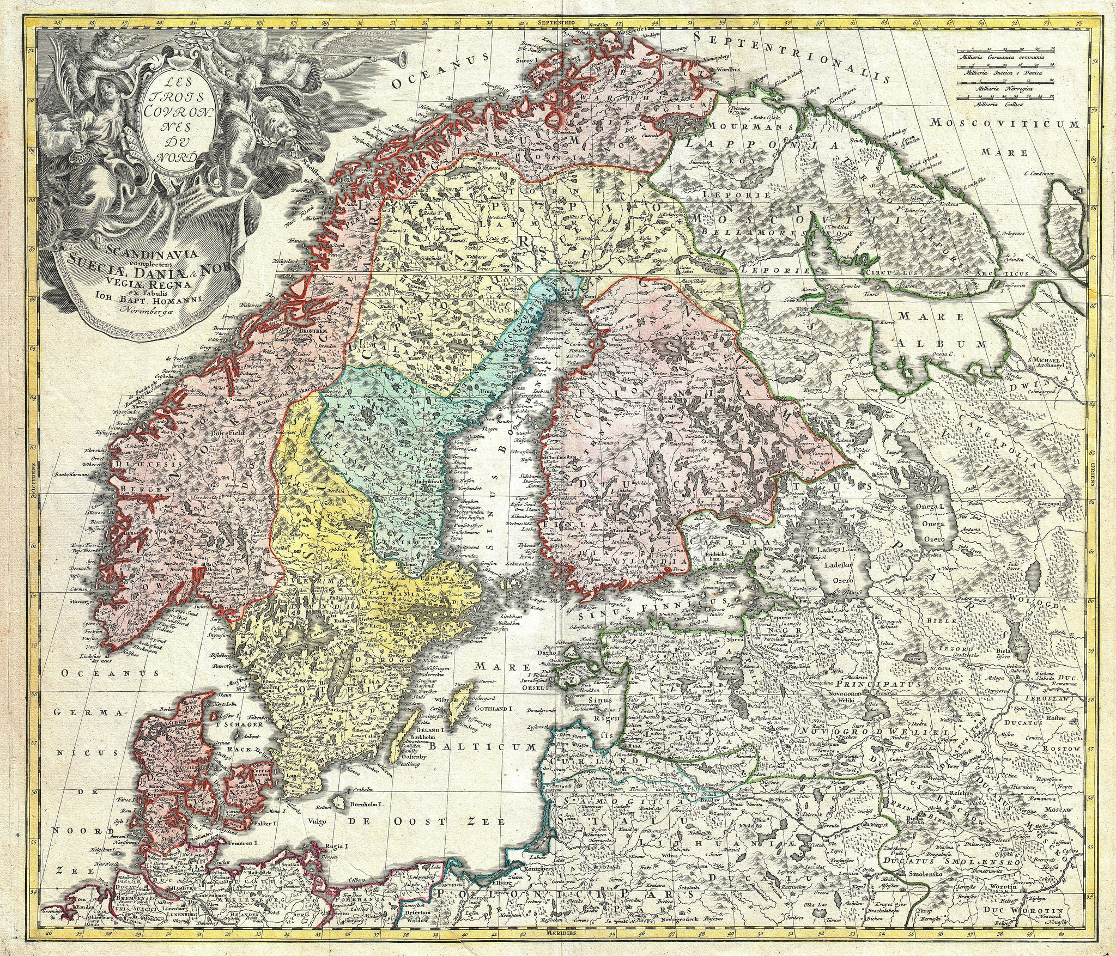
Why is research data management important to you?
Enabling working with data efficiently
Being aware of important requirements, regulations and most importantly where to find support and help
Enabling delivery on funder and employer requirements easier
Image by saamiblog, licensed under CC BY 2.0

Slide 15
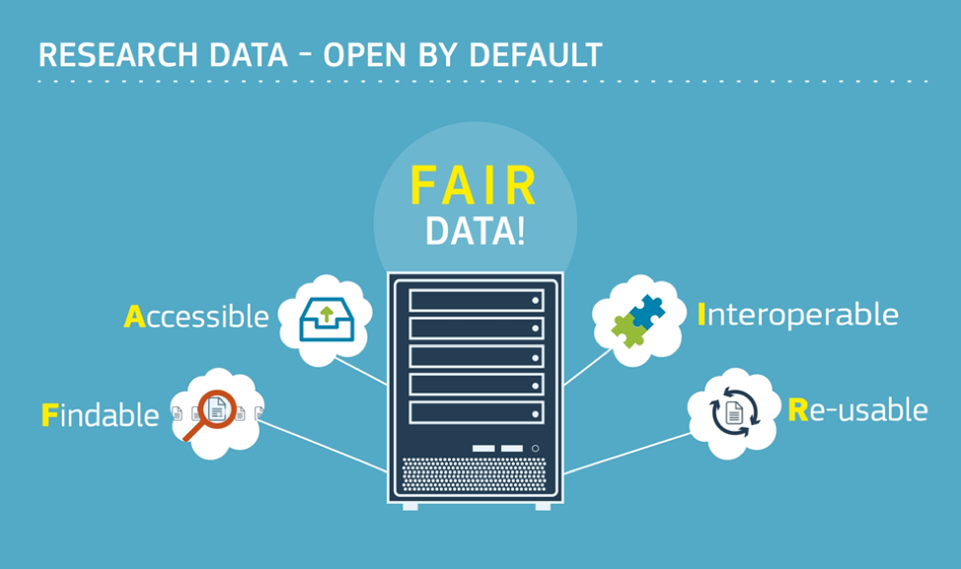
Source: https://en.wikipedia.org/wiki/FAIR_data

Slide 16
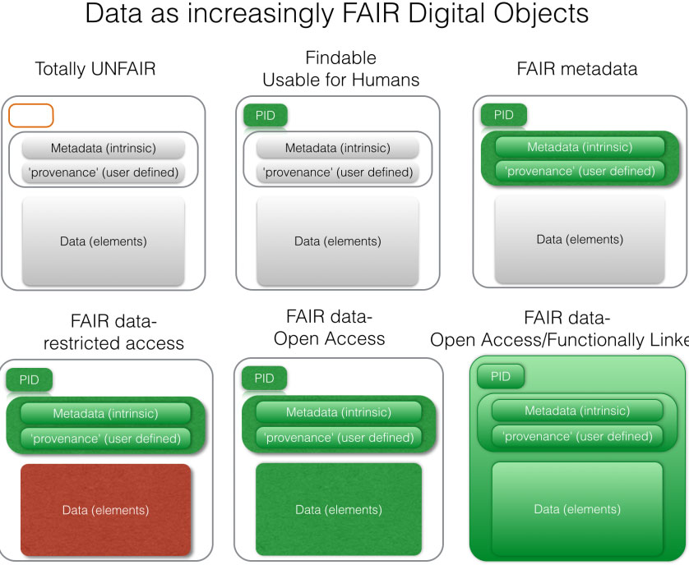
Source: FORCE11.org

Slide 17
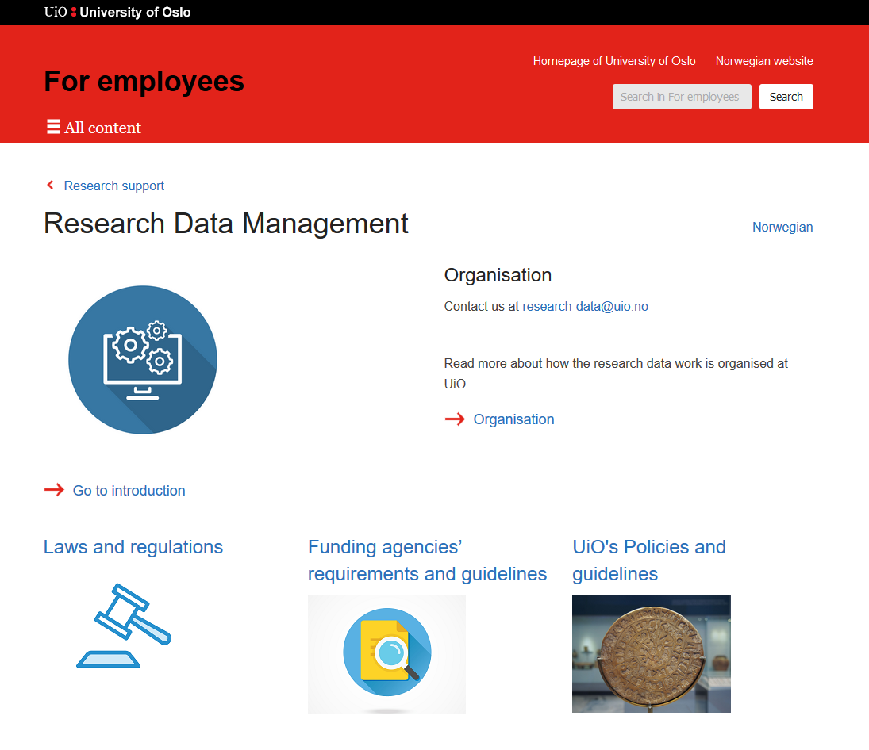

Slide 18

University of Oslo policy
The University of Oslo wants to manage research data according to international standards, such as the FAIR principles, and thereby support the development of a global research community in which research data is widely shared. This should contribute to:
improved quality of research through a better opportunity to build on previous works and to compile research data in new ways
transparency in the research process and better opportunity for verifiability of scientific results
increased cooperation and less duplication of research work
increased innovation in the private and public sectors
efficiency improvement and better utilization of public funds
Notes:
https://www.uio.no/english/for-employees/support/research/research-data-management/policies-and-guidelines/

Slide 19
University of Oslo guidelines
Research data must be made openly available for reuse
Research data must have a data management plan
Research data must have metadata
Research data must be archived in a responsible manner
Research data must be equipped with licenses for access, reuse and redistribution
Research data must be made available as early as possible
Research data must be made openly available, but costs for distribution can be covered

Slide 20

Open by default as the key principle
  Data created through research funded by the Research Council
The R&D-performing institution must assess the need to develop a data management plan in relation to all projects awarded Research Council funding. If you decide that a data management plan is not needed, you must provide an explanation.
This plan must be delivered in connection with the revised grant application.
We will request a final version of the data management plan in connection with the final report of the project.

Slide 21
The plan is a living document that follows the research project and specifies the following:
the kind of data that will be generated;
how the data will be described;
where the data will be stored;
whether and how the data can be shared.
Services and tools for support:
Norwegian Centre for Research Data (NSD)
Digital Curation Centre (DCC, UK)
easyDMP (data management plan) (Sigma2)
UiO template – soo to be launched

Slide 22
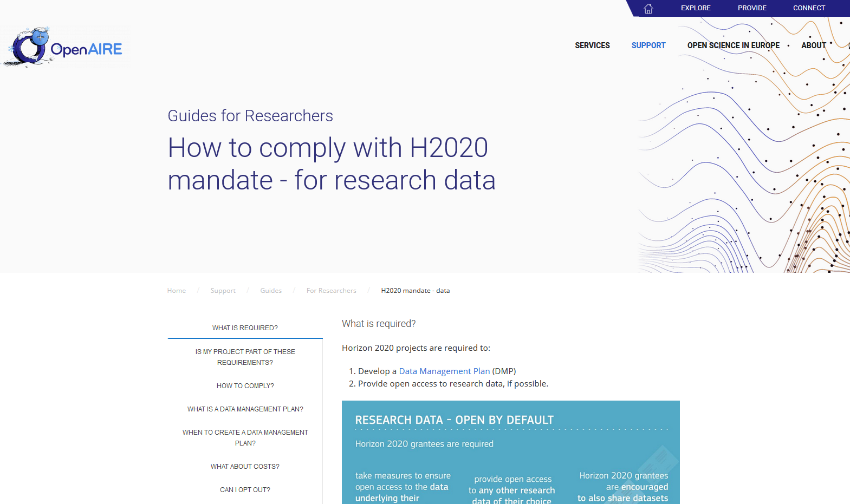
Source: https://www.openaire.eu/how-to-comply-to-h2020-mandates-for-data

Slide 23
Sources:
Anne Bergsaker og Live Håndlykken Kvale. Datahåndtering, kurs 25.9.2019
CESSDA. Data management expert guide. https://www.cessda.eu/Training/Training-Resources/Library/Data-Management-Expert-Guide
Christine L. Borgman. 2015. Big Data, Little Data, No Data: Scholarship in the Networked World. The MIT Press.
Forskningsrådets policy for åpen forskning https://www.forskningsradet.no/nyheter/2020/slik-skal-forskningsradet-jobbe-for-apen-forskning/
Forskningsrådet. Forskningsrådets policy for åpen tilgang til forskningsdata: https://www.forskningsradet.no/forskningspolitisk-radgivning/apen-forskning/apen-tilgang-til-forskningsdata/
OpenAire. Guides for researchers: How to comply with h2020 mandate – for research data. https://www.openaire.eu/how-to-comply-to-h2020-mandates-for-data
University of Oslo. Policies and guidelines for research data management https://www.uio.no/english/for-employees/support/research/research-data-management/policies-and-guidelines/index.html

