Slide 1
Research ethics and privacy and data protection
Elin Stangeland, University of Oslo Library, Digital services
Lars Soligard, USIT
Ivana Malovic, Science Library
Marianne Inez Lien, Humanities and Social Sciences Library
Matthew Good, Science Library
Building upon materials created by Anne Bergsaker, USIT

Slide 2
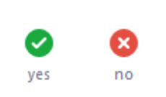
Zoom Feedback Test
Open the menu “Participants” and click on “Yes” in the bottom of the menu.

Slide 3
Research ethics
Research ethics is an important foundation for good research practice. Anyone who conducts research at UiO are required to be aware of ethical aspects of research.
The term research ethics refers to a wide variety of values, norms, and institutional arrangements that help constitute and regulate scientific activities.
Research ethics is a codification of scientific morality in practice.
Guidelines for research ethics specify the basic norms and values of the research community.

Slide 4
Question 1
Have you received training in research ethics either at UiO or somewhere else?

Slide 5
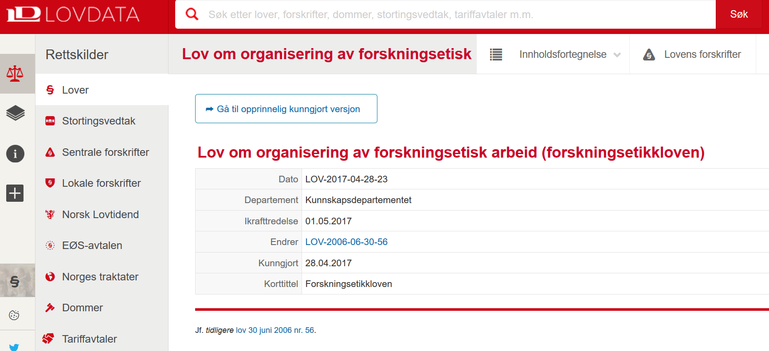
Source (in Norwegian): https://lovdata.no/dokument/NL/lov/2017-04-28-23

Slide 6

Ethics principles
Respect. People who participate in research, as informants or otherwise, shall be treated with respect.
Good consequences. Researchers shall seek to ensure that their activities produce good consequences and that any adverse consequences are within the limits of acceptability.
Fairness. All research projects shall be designed and implemented fairly.
Integrity. Researchers shall comply with recognized norms and to behave responsibly, openly and honestly towards their colleagues and the public

Slide 7
14 guidelines
Quest for truth
Academic freedom
Quality
Voluntary informed consent
Confidentiality
Impartiality
Integrity
Good reference practice
Collegiality
Intitutional responsibility
Availability of results
Social responsibility
Global responsibility
Laws and regulations
Source: https://www.forskningsetikk.no/en/guidelines/general-guidelines/

Slide 8

https://www.forskningsetikk.no/en/guidelines/social-sciences-humanities-law-and-theology/guidelines-for-research-ethics-in-the-social-sciences-humanities-law-and-theology/

Slide 9

Responsibilities
The University
Heads of departments
Researchers

Slide 10
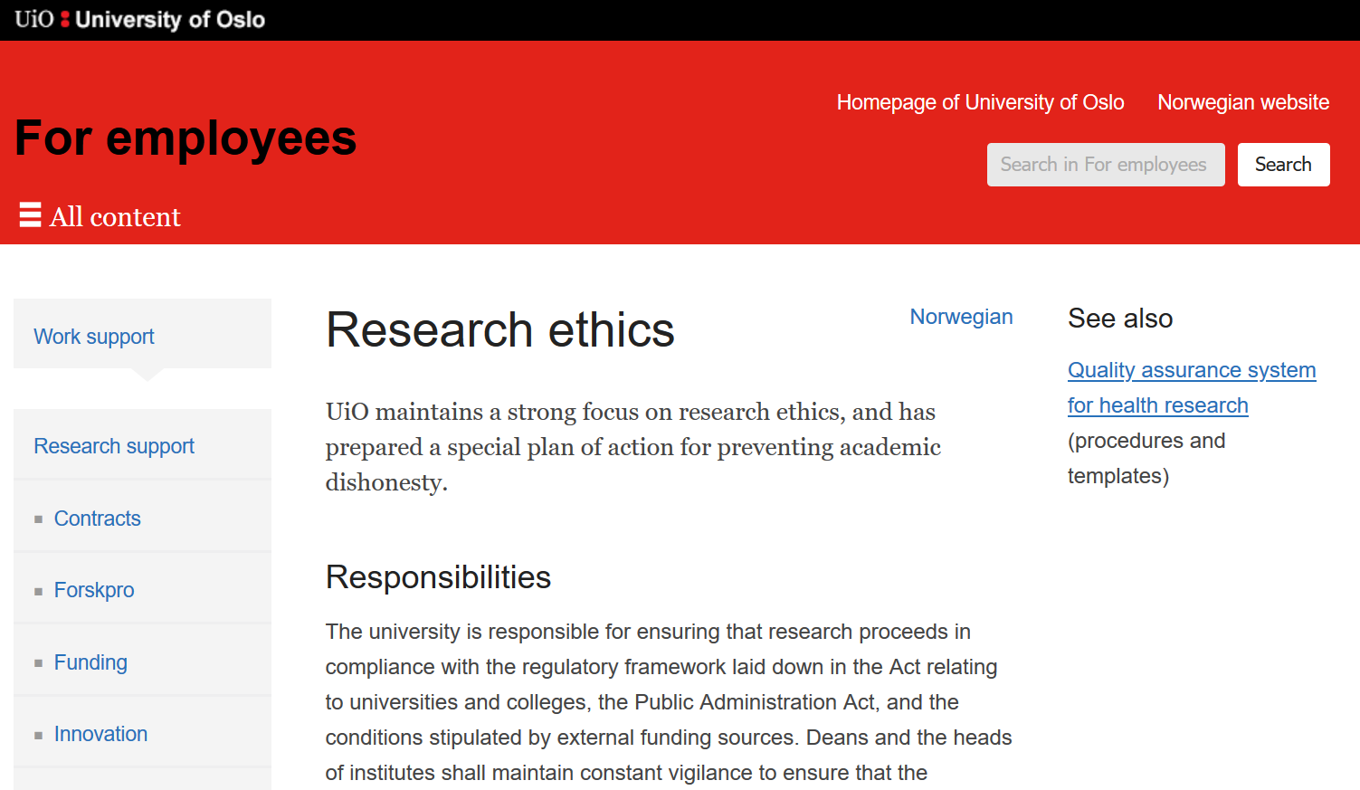
Source: https://www.uio.no/english/for-employees/support/research/ethics/

Slide 11
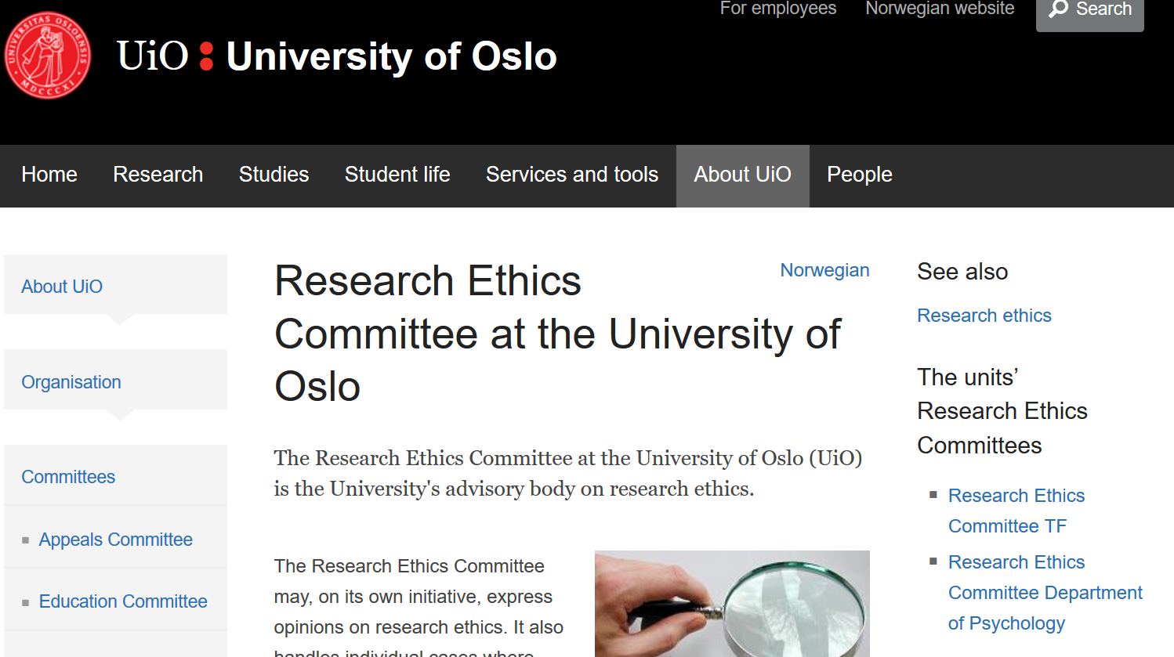
Source: https://www.uio.no/english/about/organisation/committees/research-ethics-committee/

Slide 12
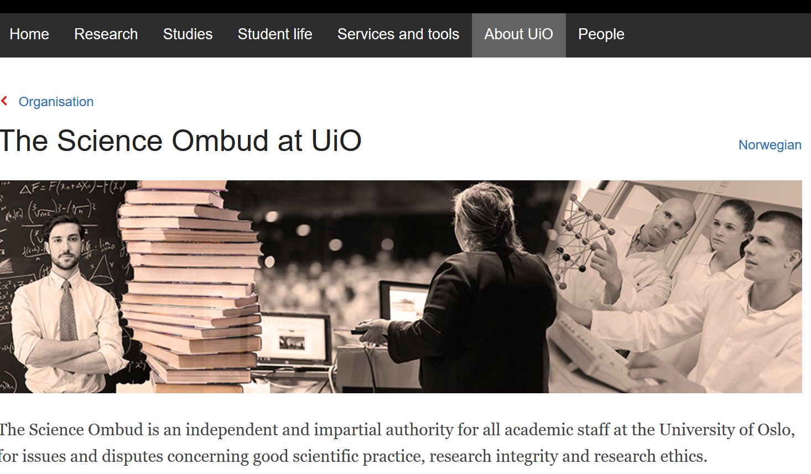
Source: https://www.uio.no/english/about/organisation/science-ombud/

Slide 13
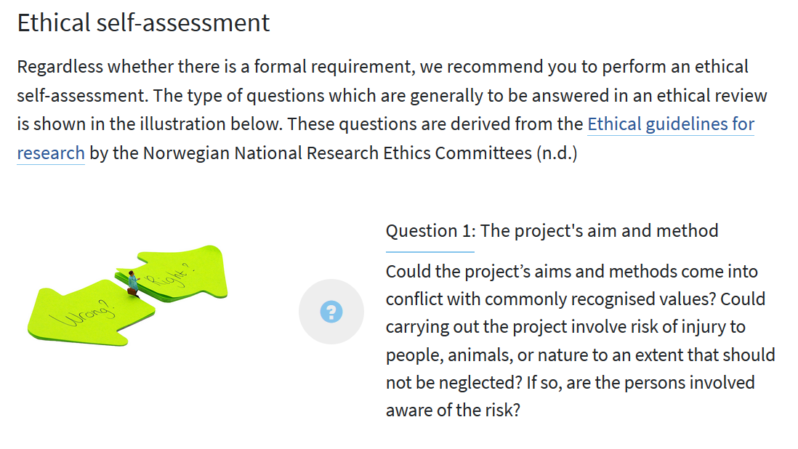
Source: https://www.cessda.eu/Training/Training-Resources/Library/Data-Management-Expert-Guide/5.-Protect/Ethical-review-process

Slide 14

The principles of privacy and data protection
Legality
Fairness
Openness
Purpose limitation
Data minimisation
Accuracy
Storage limitation
Integrity and,
Confidentiality
Responsibility
Source: https://gdpr-info.eu/art-5-gdpr/ adapted by Lars Soligard

Slide 15
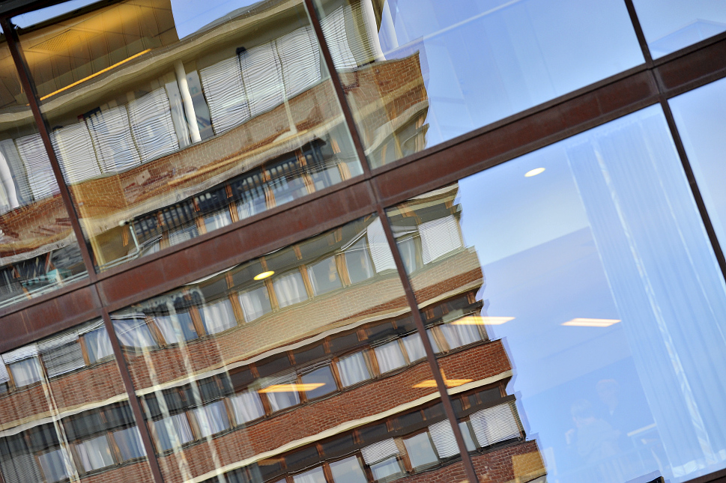
Data controller & Data protection Officer
The data controller - is the person, business or institution which alone, or with others, decides the goal of the processing and what means that are used to achieve the goal.
For any research taking place at the University of Oslo – the University is the data controller.
Data protection officer – safeguards the personal privacy interests of UiO employees, students, guest researchers, guests and respondents or informants in research projects.
Photo: UiO/Anders Lien

Slide 16
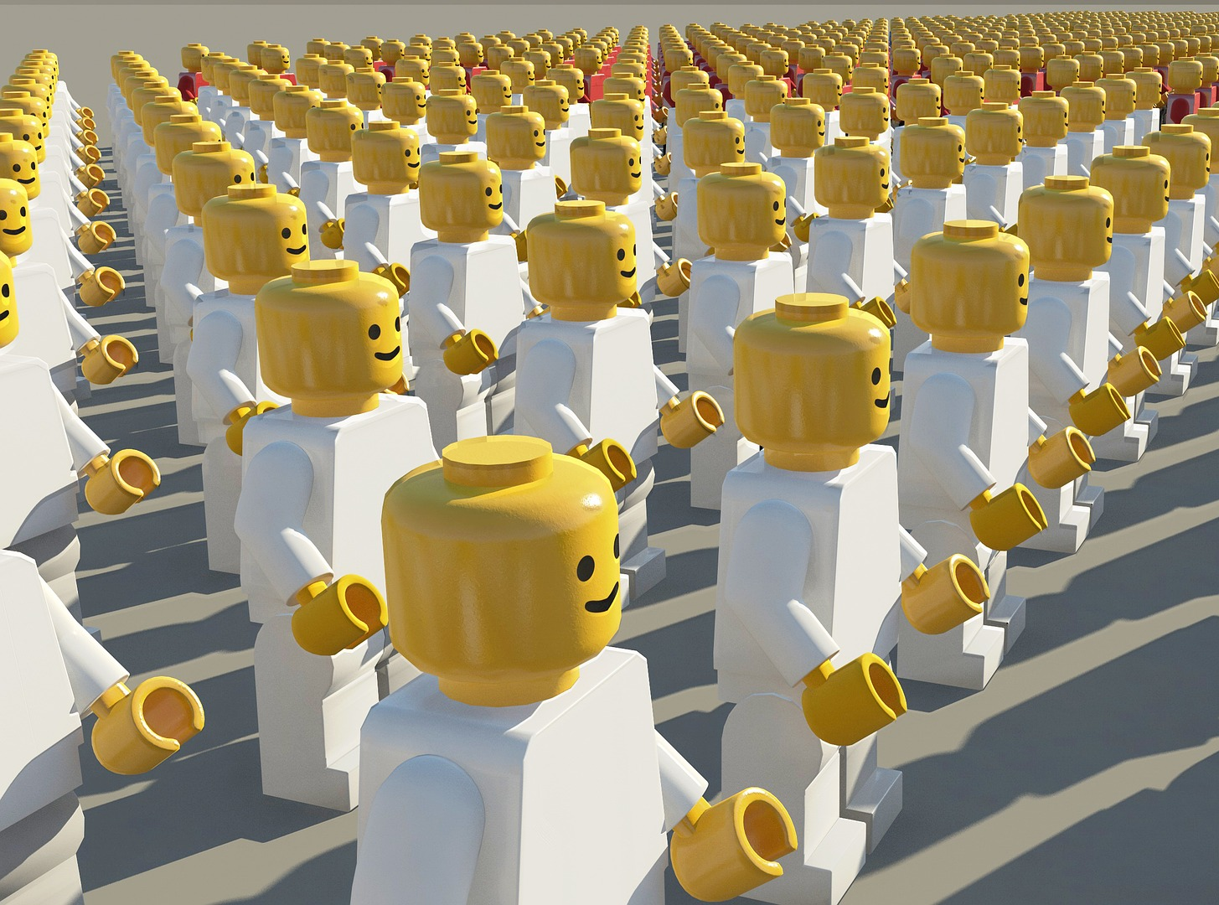
Privacy and data protection
Personal data – any piece of information about an identified or identifiable physical person.
We separate between general personal data and special categories of personal data (sensitive data)

Slide 17

What constitutes as general personal data?
Name, address, age, phone number, e-mail and Norwegian national identity number
Content of exam papers, bachelor- or master theses and candidates grades
Content of case documents, investigations or considerations of staff or students
Contents of email communication amongst staff or students or between two or more students
Video- and audio recordings where individuals are recognizable
Images of staff or students which are published on the home page
Logging of activity in computer systems where the logs can be associated with staff or students, for example when registering who is logged in to a computer system at any given time

Slide 18
Question 2
Will you be processing general personal data in your project?

Slide 19

Special categories of personal data (sensitive data)?
health information and health related conditions
genetic or biometric information which can be used to identify a physical person
ethnic or racial origin
political, philosophical or religious perceptions and beliefs
sexual orientation or sexual relationships
trade-union membership

Slide 20
Question 3
Will you be processing special categories of personal data in your project?

Slide 21
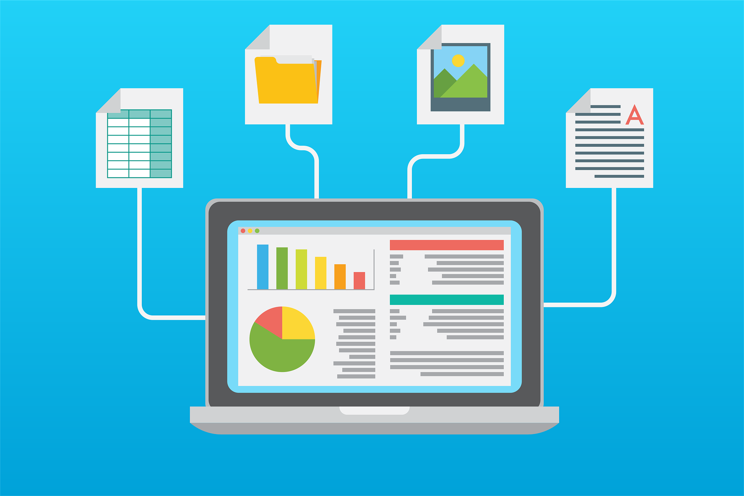
What is considered processing of personal data?
Collection
Registration
Storage
Compilation
Use
Transfer
Publication
Erasure

Slide 22

De-identified and anonymous data?
De-identified data means that information used for identification have been replaced by a code with an associated key. De-identified data are seen as personal data. If you delete the associated key, de-identified data can be anonymous.
Anonymous data means that NO ONE can identify persons in a dataset. Anonymous data are not seen as personal data. Data can in some cases be anonymised by deleting any information that contributes towards identification.

Slide 23
De-identified and anonymous data?
De-identified data means that information used for identification have been replaced by a code with an associated key. De-identified data are seen as personal data. If you delete the associated key, de-identified data can be anonymous.
Anonymous data means that NO ONE can identify persons in a dataset. Anonymous data are not seen as personal data. Data can in some cases be anonymised by deleting any information that contributes towards identification.

Slide 24
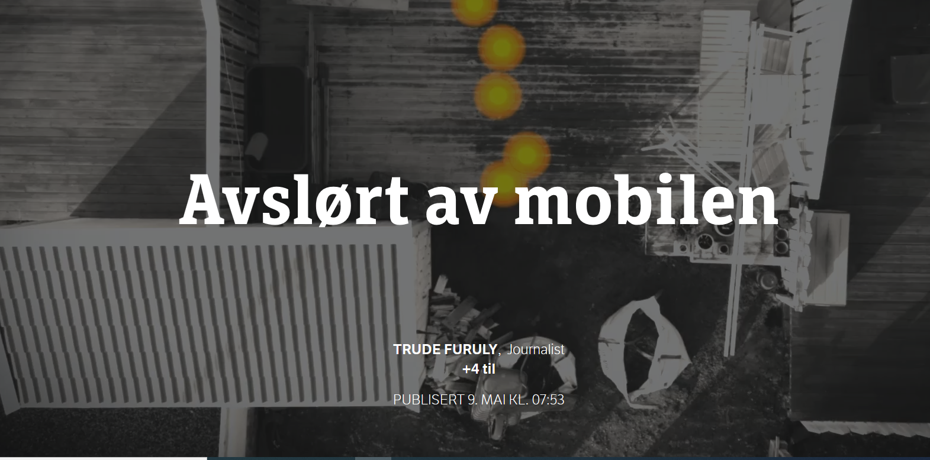

Source NRK (in Norwegian): https://www.nrk.no/norge/xl/avslort-av-mobilen-1.14911685

Slide 25

What is the researchers responsibility?
Project managers are responsible for the privacy of the participants when their personal data are to be processed. They must:
determine and maintain an overview of what types of personal data shall be processed in the research project
prepare a consent form and information about rights to be presented to respondents or informants
Notify the project to NSD
If needed, enter data processor agreements with external information or service providers
Ensure that appropriate technical solutions for collection, storage, transmission and analysis are utilised.
Ensure that project staff are trained in securely processing of personal research data

Slide 26
Question 4
Will be you be in charge of privacy protection for your project?

Slide 27
Information for research subjects
Contact information of the Data Controller and the Data Protection Officer
Details about the processing purpose and legal basis for the processing
Who will have access
The time period the information will be stored
Information about any other rights they have according to the Privacy Act.
NSD has a lot more information about how to do this well: https://nsd.no/personvernombud/en/help/information_consent/information_requirements.html

Slide 28

Consent
For a consent to be valid and work as a basis for processing, it must be:
Voluntary
Specific
Informed
Unequivocal
Given actively
Documentable
Possible to withdraw as easily as it was given
If you wish to use the data for a new/different purpose, a new consent must be obtained from the data subject.

Slide 29
Handling consent in TSD
TSD = UiOs service for sensitive data
At UiO a TSD Consent portal is available
  Makes it easier to manage consents
  And for research contributors to log in and remove consent
  Data is captured via the nettskjema.no tool or it can be imported
  Information can be found on the USIT web pages: https://www.uio.no/english/services/it/research/sensitive-data/use-tsd/datacollection/nettskjema/consent/consent.md

Slide 30
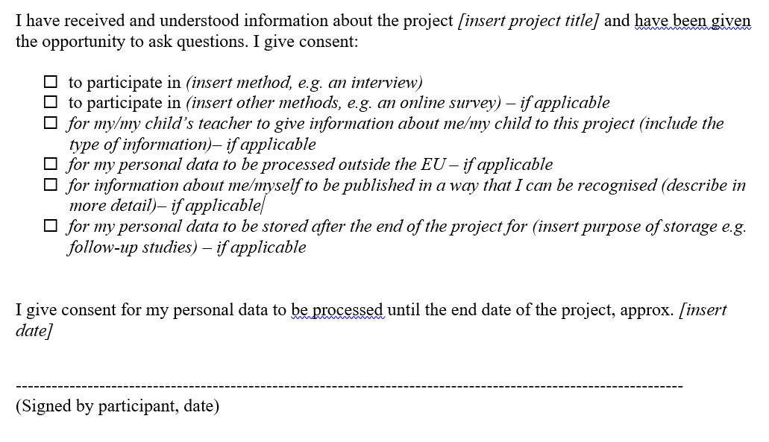

Slide 31
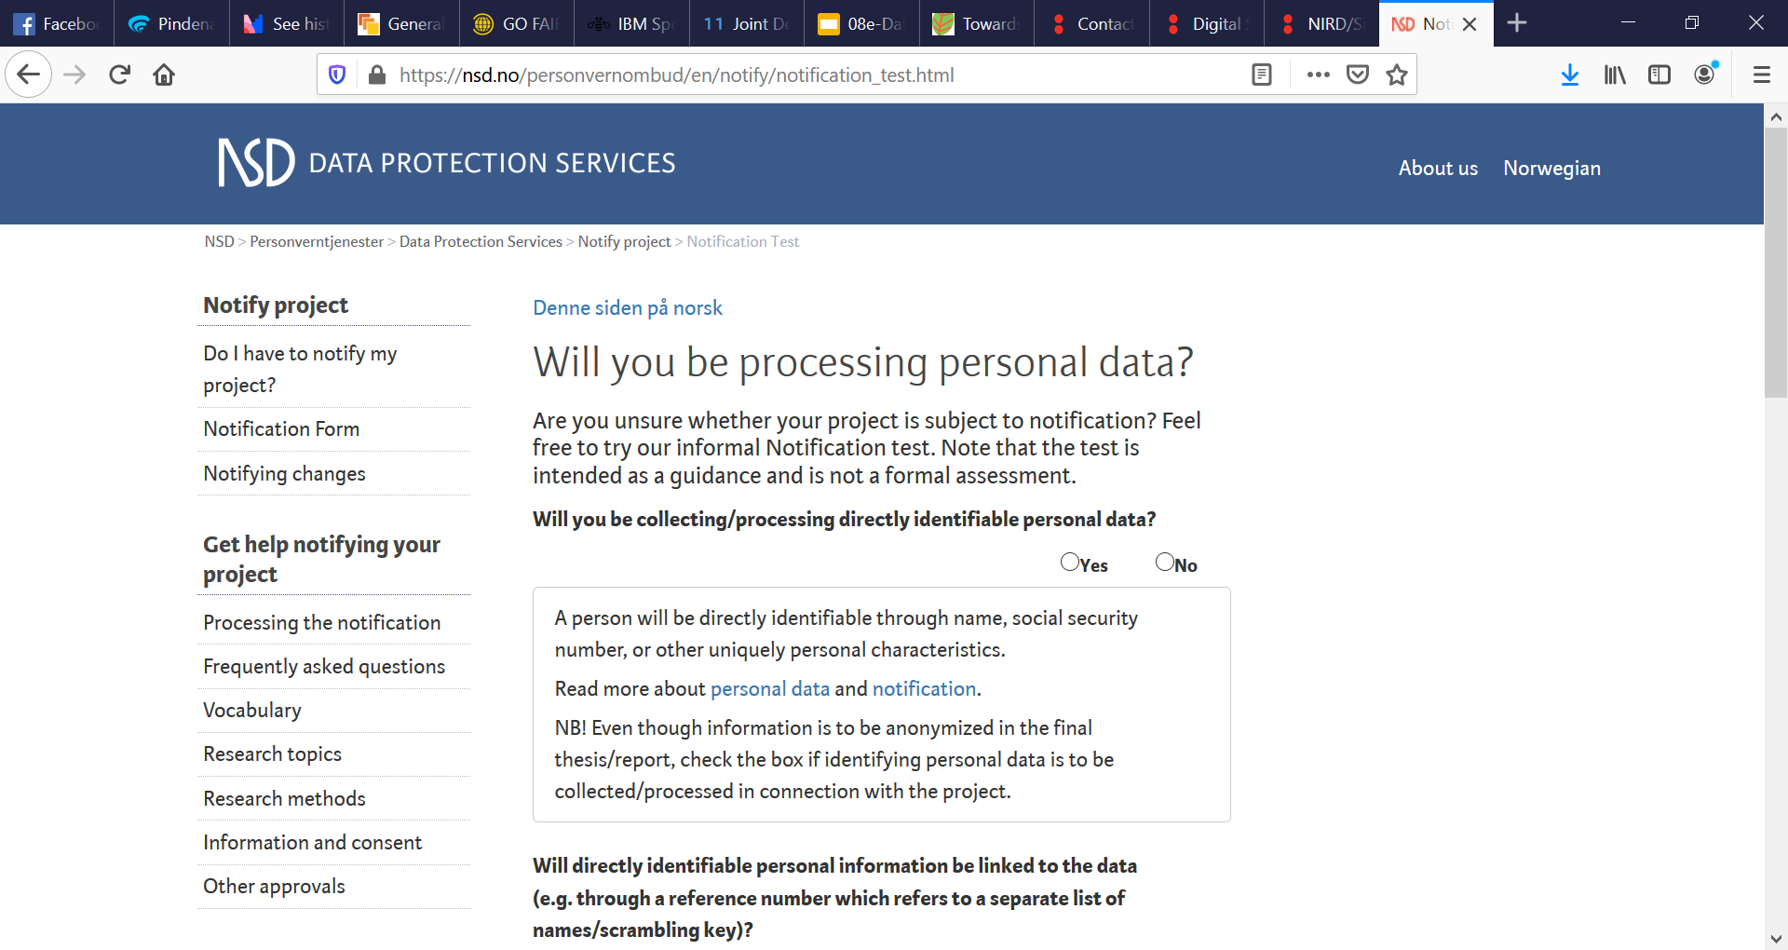
Source: https://nsd.no/personvernombud/en/notify/notification_test.html

Slide 32
Question 5
Have you notified NSD about your project yet?

Slide 33
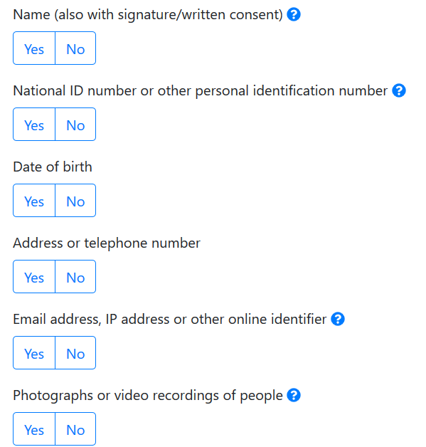
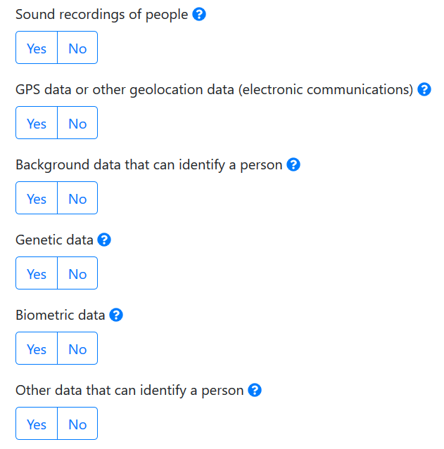

Slide 34

Data Processor agreements
The subject and duration of the processing
The nature and purpose of the processing
The type of personal data and categories of the registered
The rights and duties of the data controller
What the data processors can do with personal data for which UiO is the data controller
How personal data is safeguarded against unauthorised access, alteration, erasure, loss or damage

Slide 35
Question 6
Will you be using external organisations to assist you with data processing for your project?

Slide 36

Data Protection Impact Assessment (DPIA)
A DPIA is needed in situations when the processing involves high risks for people’s rights and liberties
The assessment takes place before the research can start
Involves an extensive review of the planned data processing, and its potential privacy protection consequences
For projects that you notify NSD about, the DPIA will be conducted by NSD

Slide 37

Do you need help, or are uncertain about something?Have you made an error? Fear not! The Data Protection Officer can help!

Slide 38
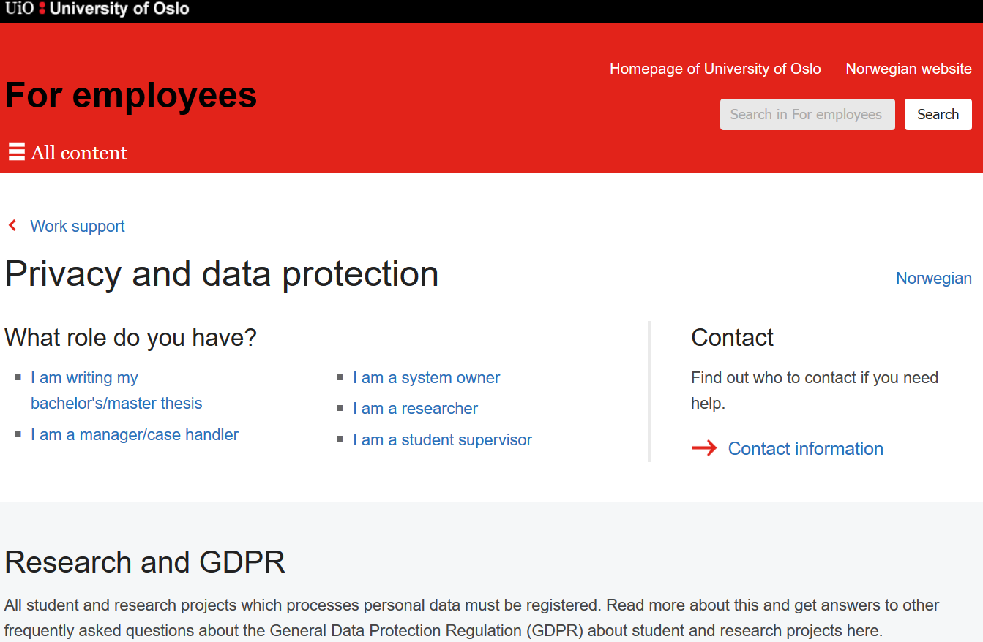
Source: https://www.uio.no/english/for-employees/support/privacy-dataprotection/index.html
Notes:
Source: https://www.uio.no/english/for-employees/support/privacy-dataprotection/index.html

Slide 39
Sources
Quality assurance system for health and medical research: https://www.uio.no/english/for-employees/support/research/quality-system-for-health-research/
NSD Data Protection services: https://nsd.no/personvernombud/en/index.html
REC templates for consent: https://helseforskning.etikkom.no/frister/malforinformasjonsskriv?p_dim=34672
University of Oslo. Privacy and data protection. https://www.uio.no/english/for-employees/support/privacy-dataprotection/
TSD consent portal. https://www.uio.no/english/services/it/research/sensitive-data/use-tsd/datacollection/nettskjema/consent/consent.md
Notes:
Sources
Will add various templates mentioned.
https://www.uio.no/tjenester/it/sikkerhet/lsis/tillegg/rutiner/using-zoom-for-red-data.html

